Slide 1
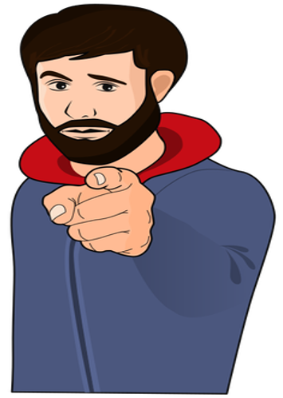
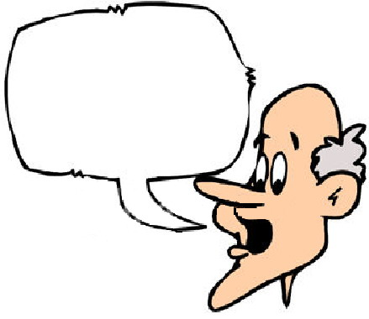
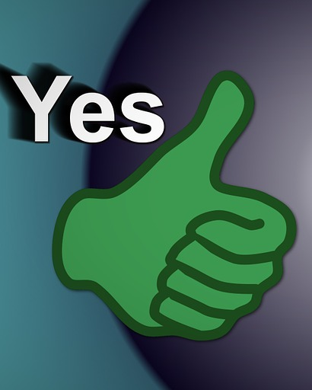
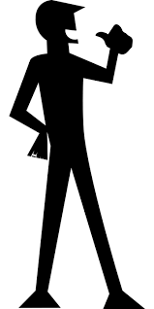



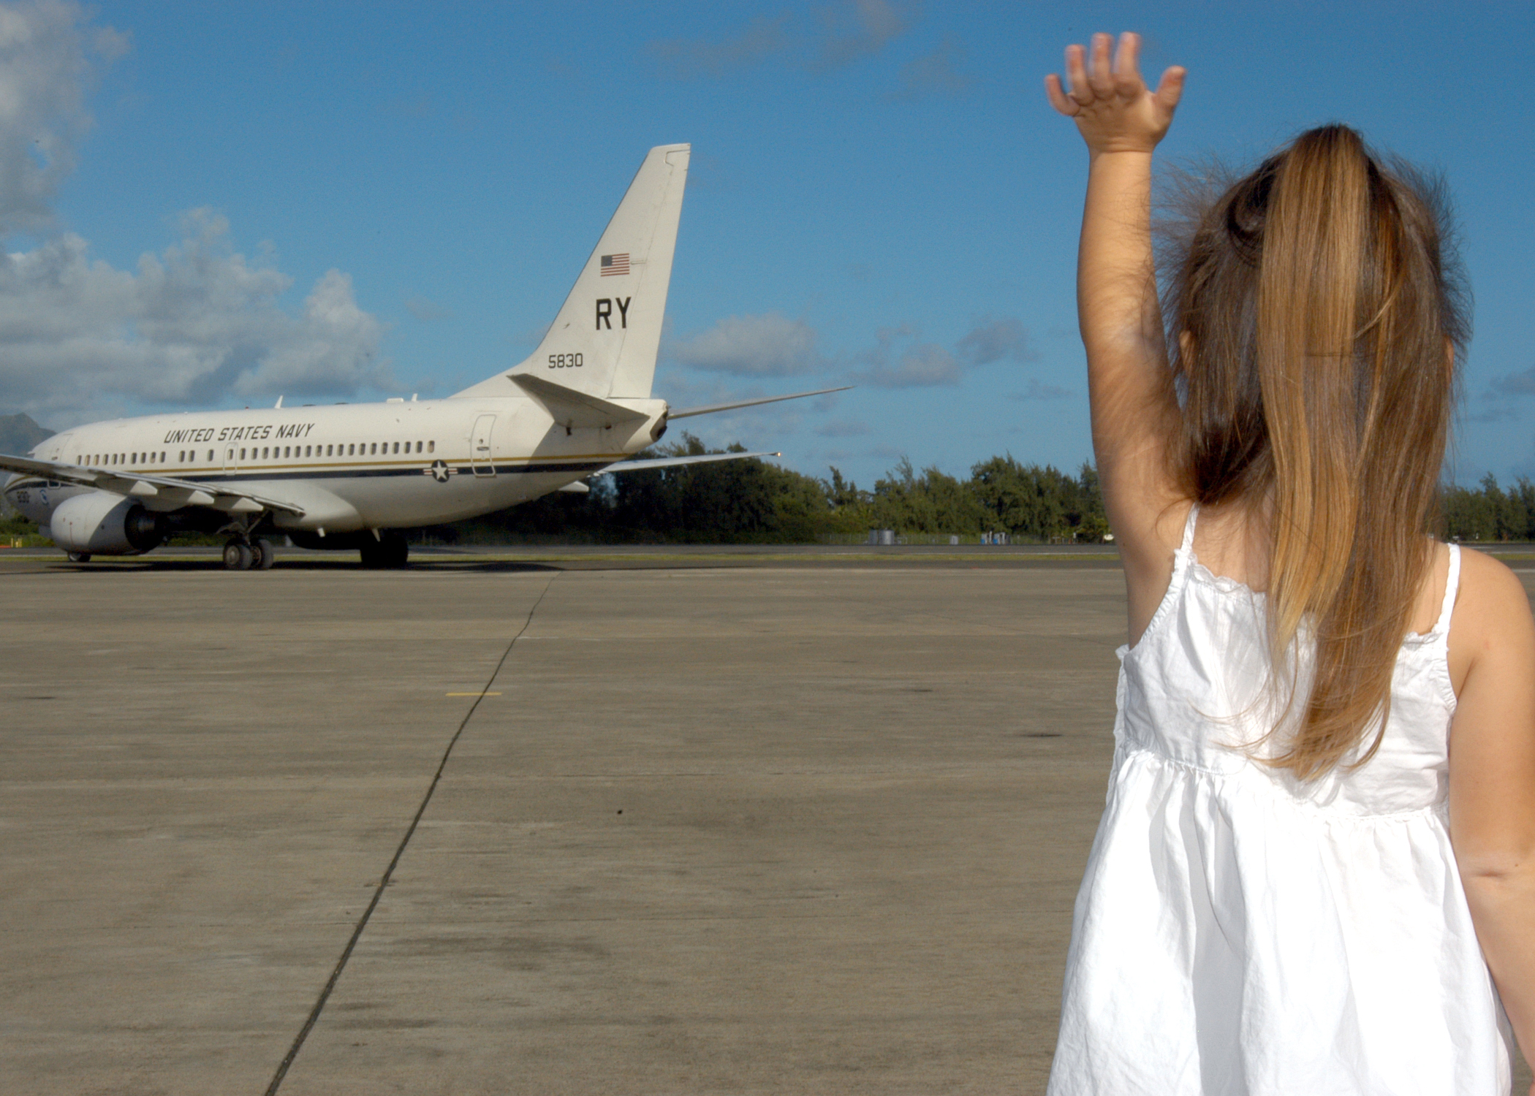
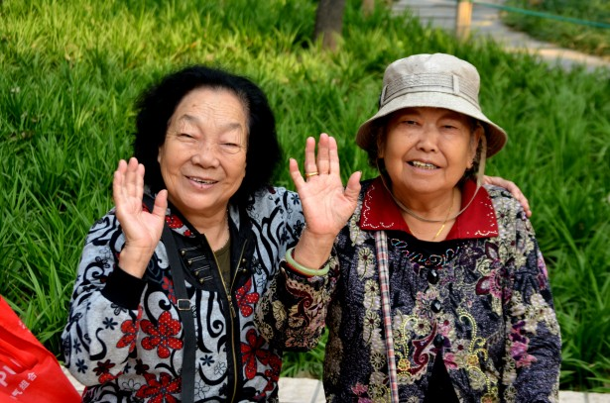


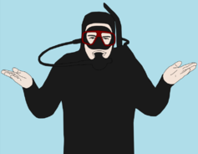
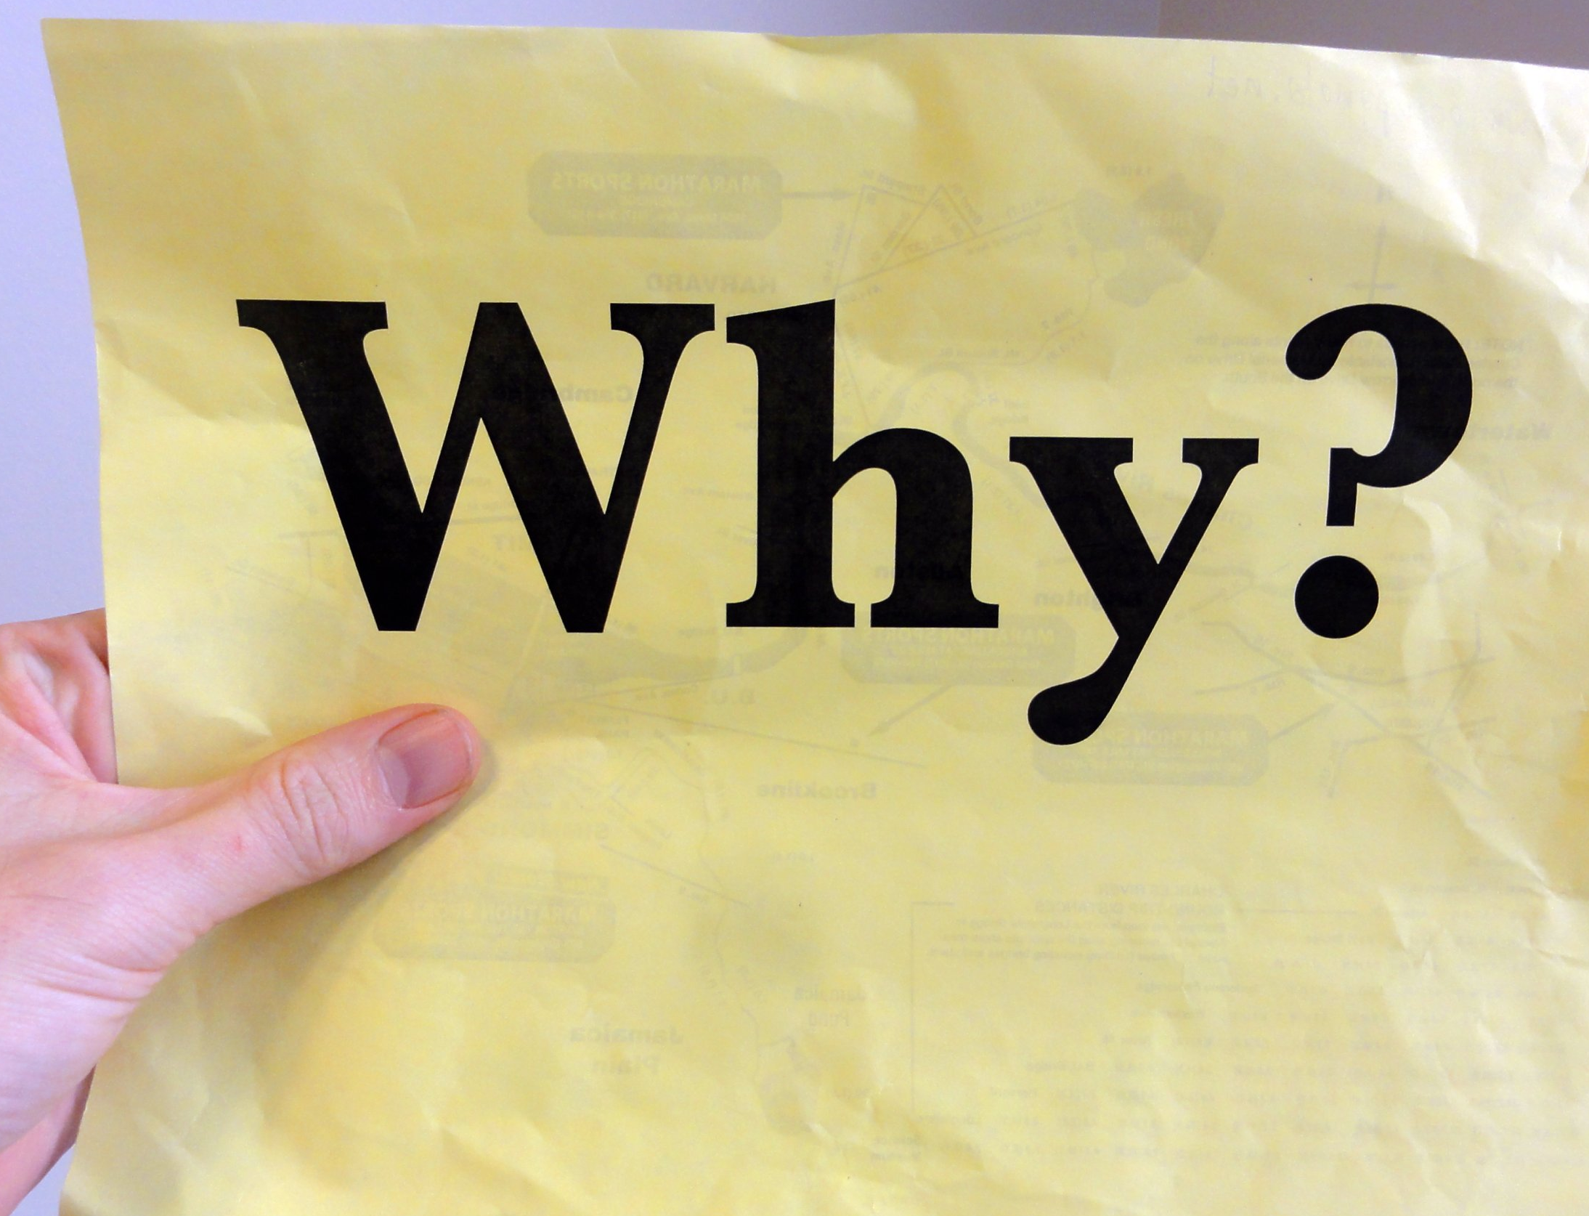
you
say
yes
I
say
no
you
say
stop
I
say
go
go
go
oh
no
you
say
goodbye
and
I
say
hello hello hello
I
don’t know
why
you
say
goodbye
I
say
hello

Slide 2
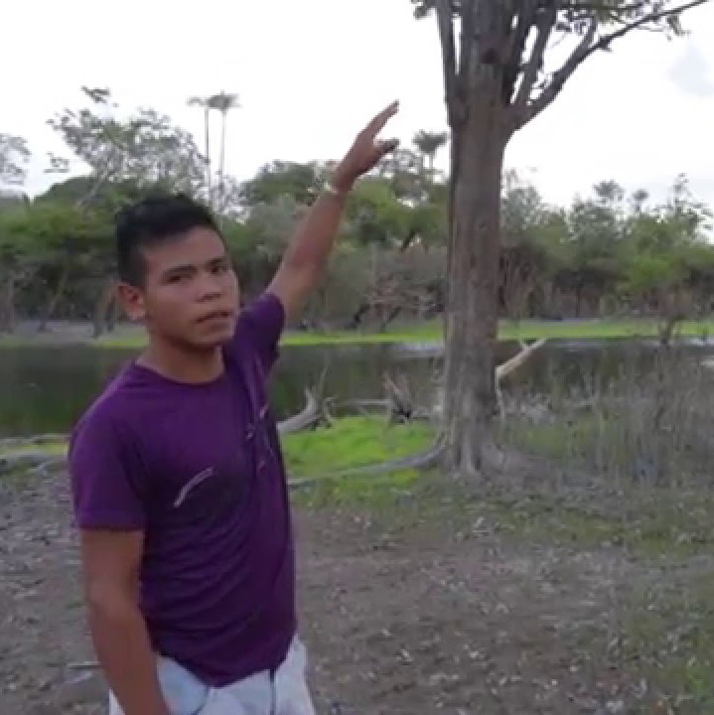
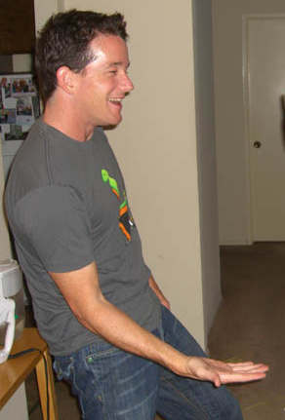
I
say
high
you
say
low
you
say
why
I
say
I
don’t know
oh
no
you
say
goodbye
and
I
say
hello hello hello
I
don’t know
why
you
say
goodbye
I
say
hello

