Slide 1
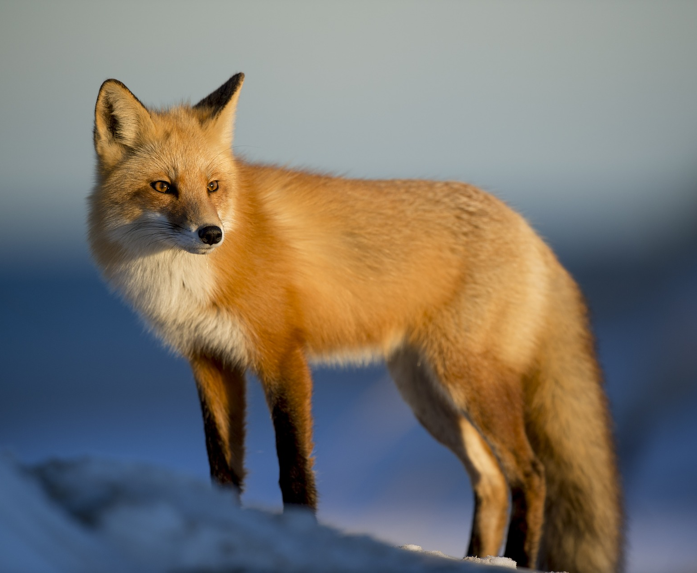
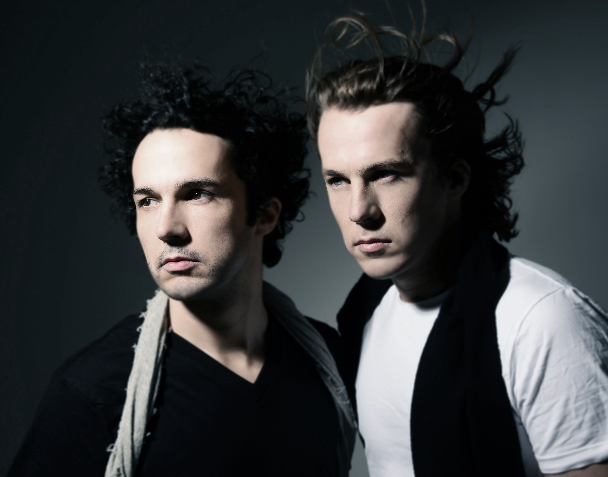
What Does the Fox Say
by Ylvis
picturelyrics.org

Slide 2
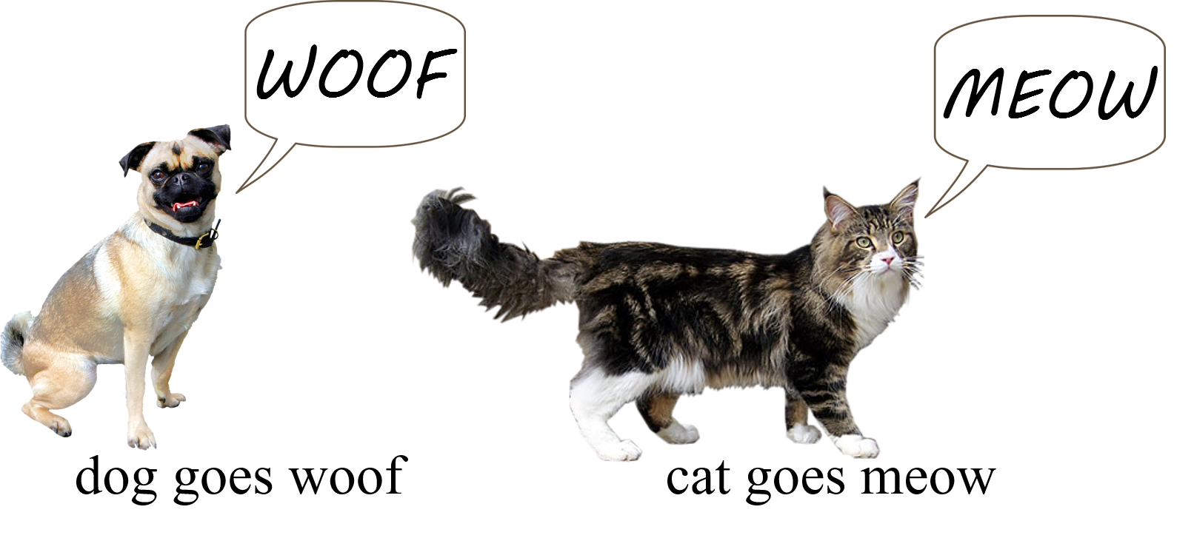
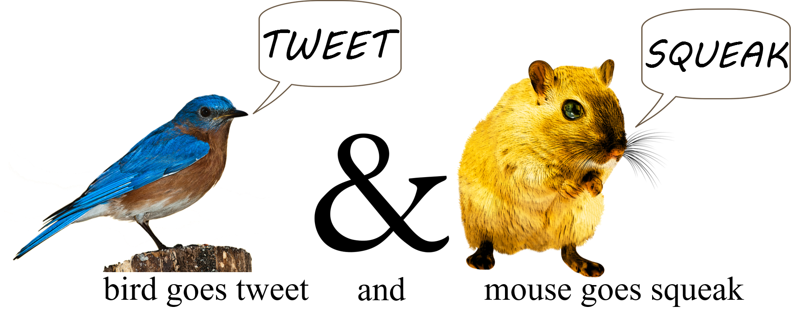
1
picturelyrics.org

Slide 3
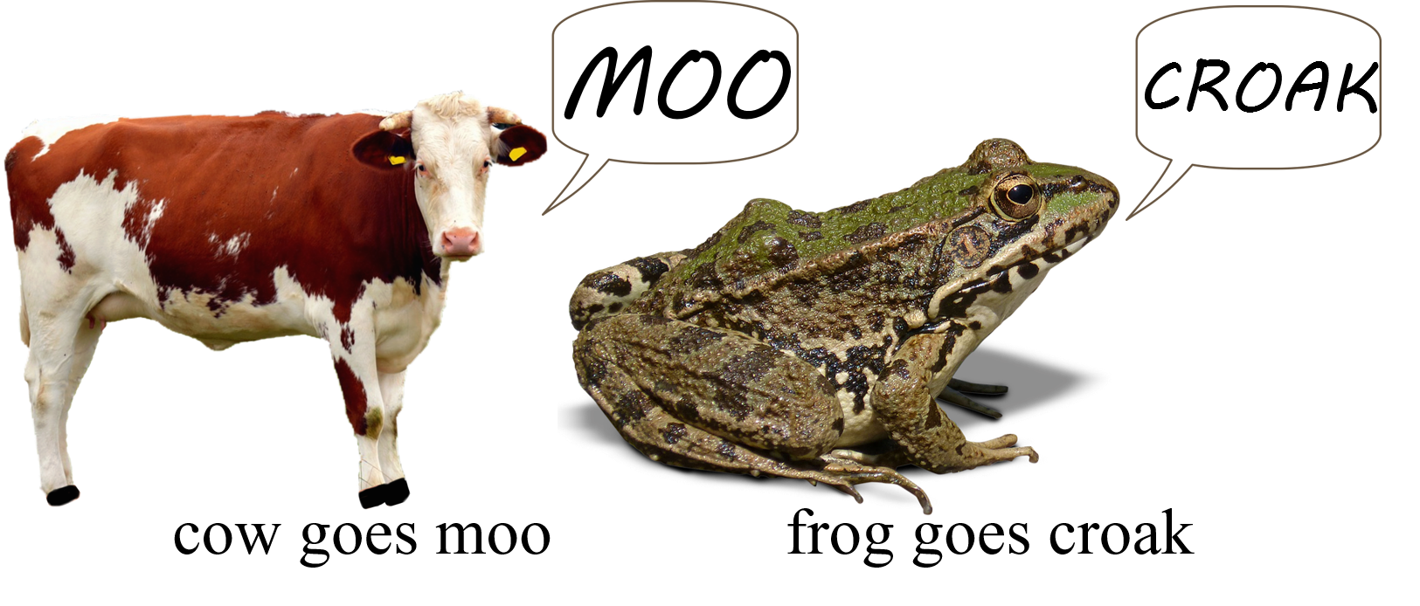
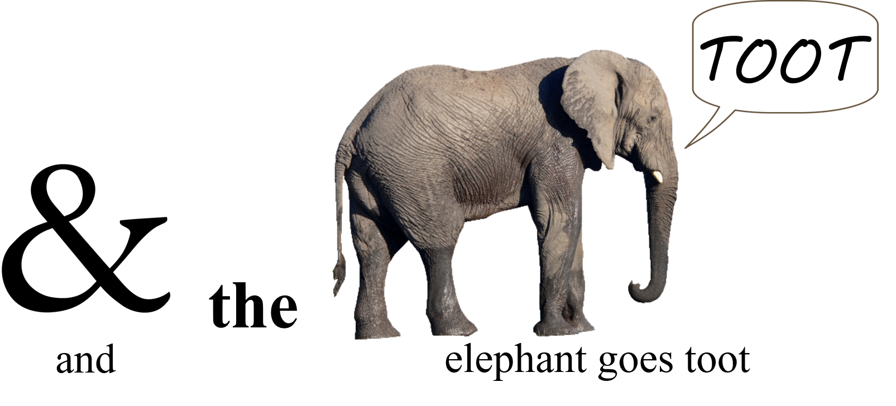
2
picturelyrics.org

Slide 4
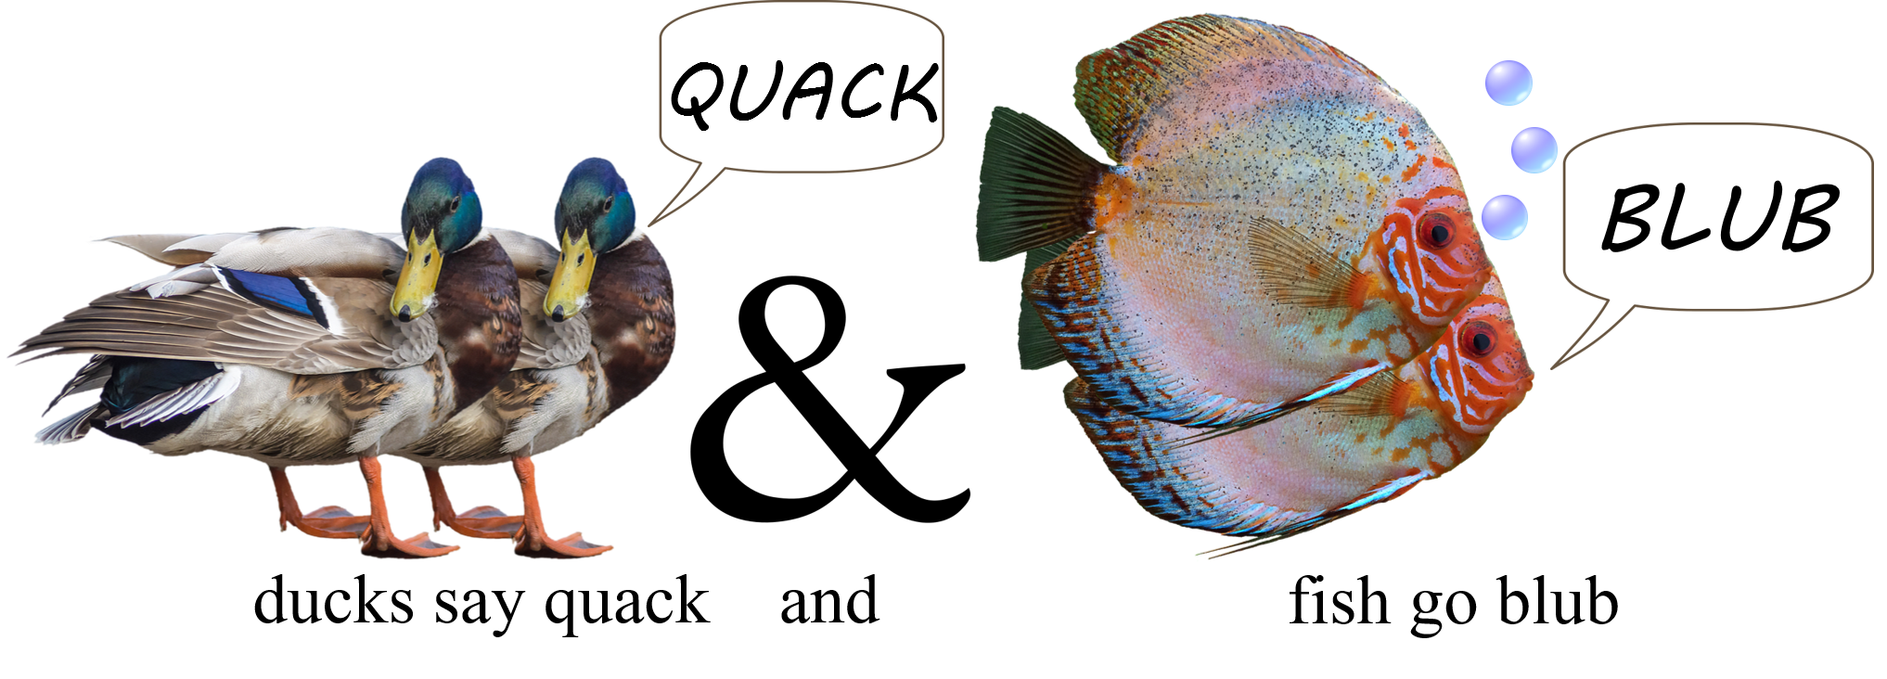
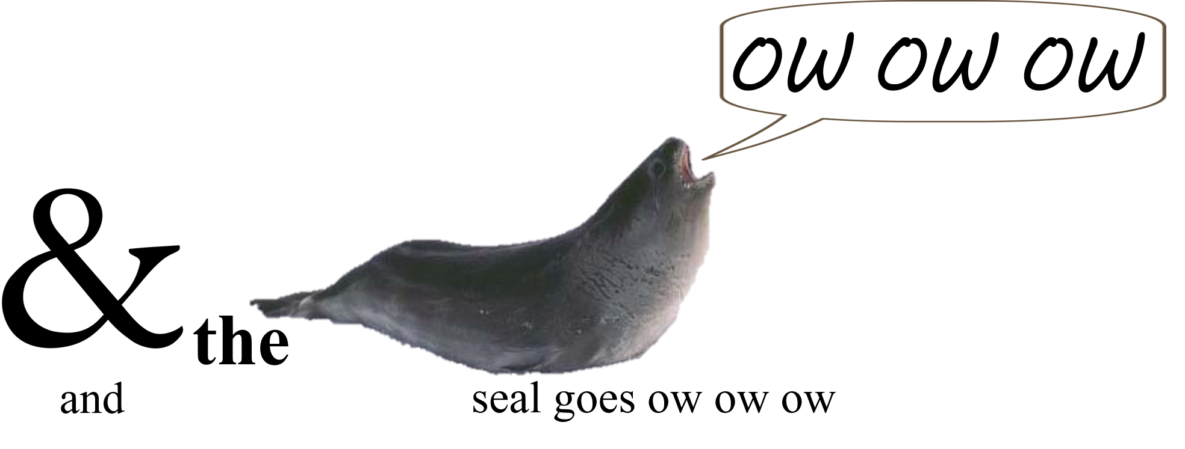
3
picturelyrics.org

Slide 5
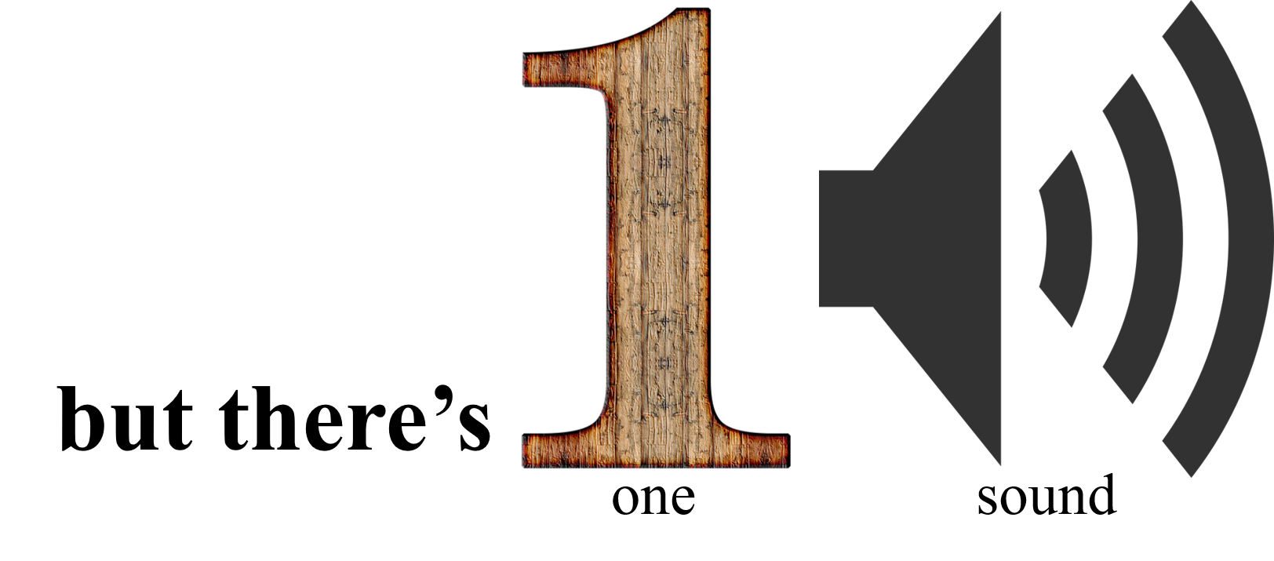
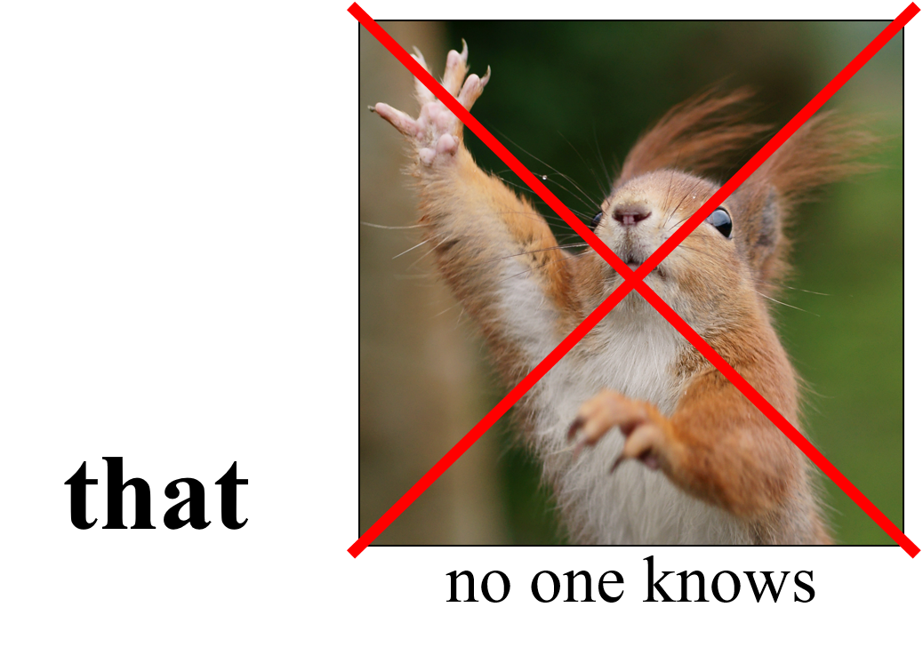
4
picturelyrics.org

Slide 6
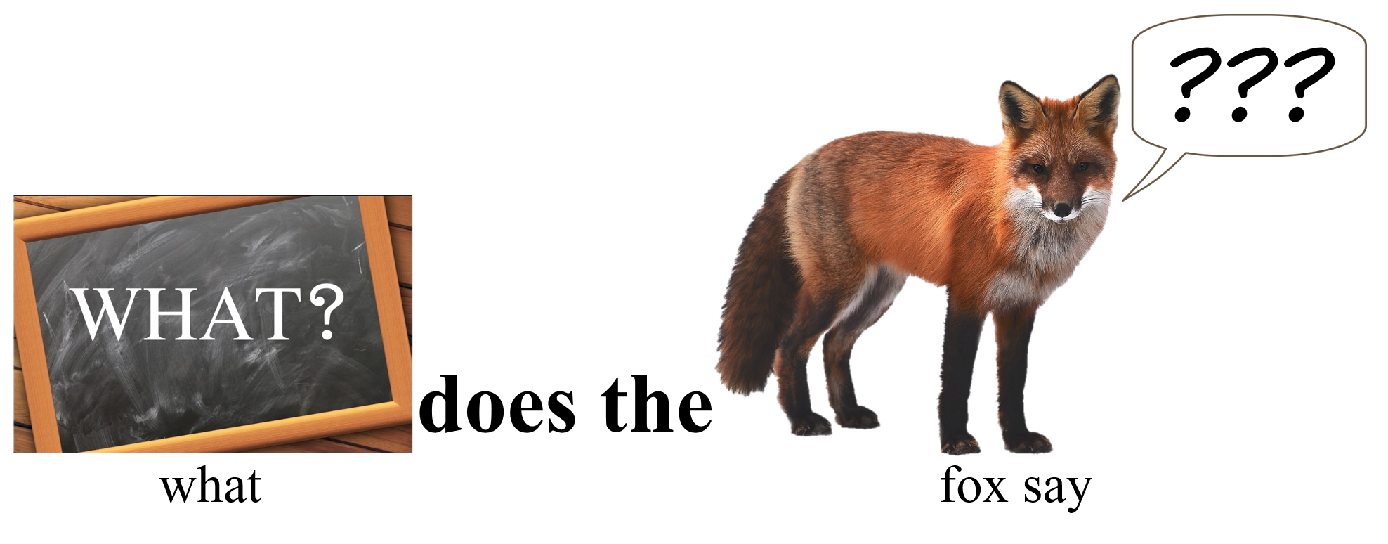

5
ring-ding-ding-ding-dinge-ringe-ding
gering-ding-ding-dinge-ringe-ding
gering-ding-ding-ding-dinge-ringe-ding
picturelyrics.org

Slide 7
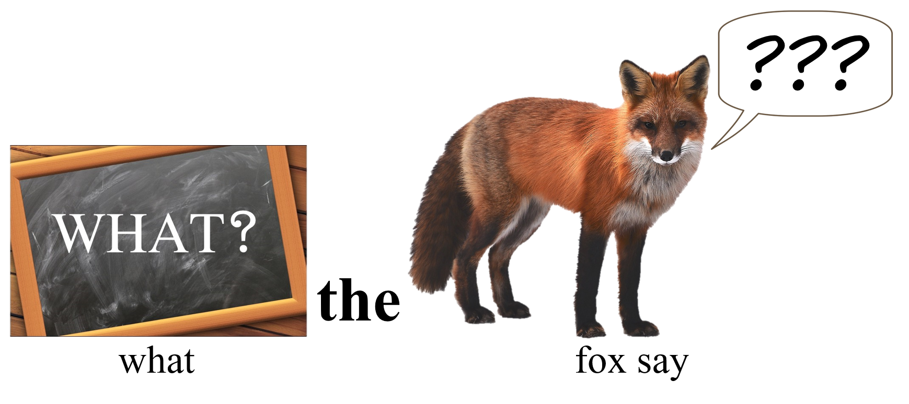


6
wa-pa-pa-pa-pa-pa-pow
wa-pa-pa-pa-pa-pow
wa-pa-pa-pa-pa-pa-pow
picturelyrics.org

Slide 8



7
picturelyrics.org
hatee-hatee-hatee-ho
hatee-hatee-hatee-ho
hatee-hatee-hatee-ho
joff-tchoff-tchoff-tchoff-tchoffo-tchoffo-tchoff
tchoff-tchoff-tchoff-tchoffo-tchoffo-tchoff
joff-tchoff-tchoff-tchoff-tchoffo-tchoffo-tchoff

Slide 9
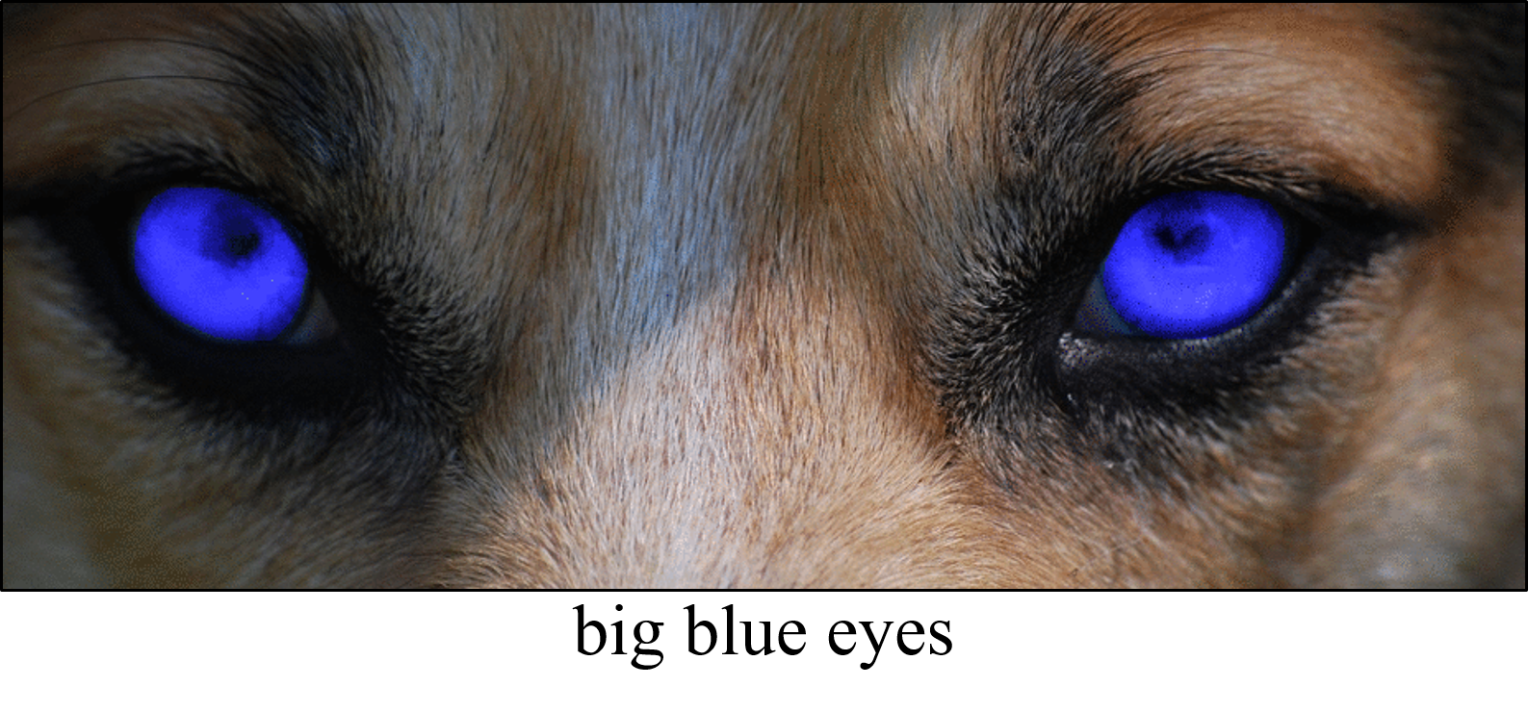
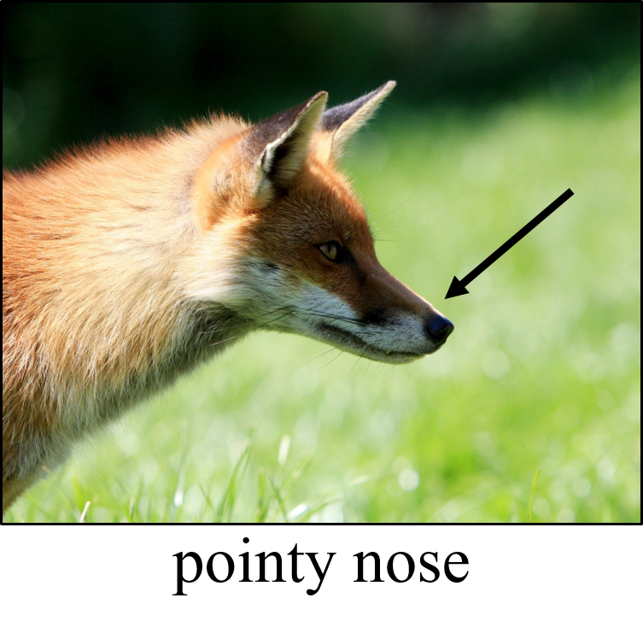
8
picturelyrics.org

Slide 10
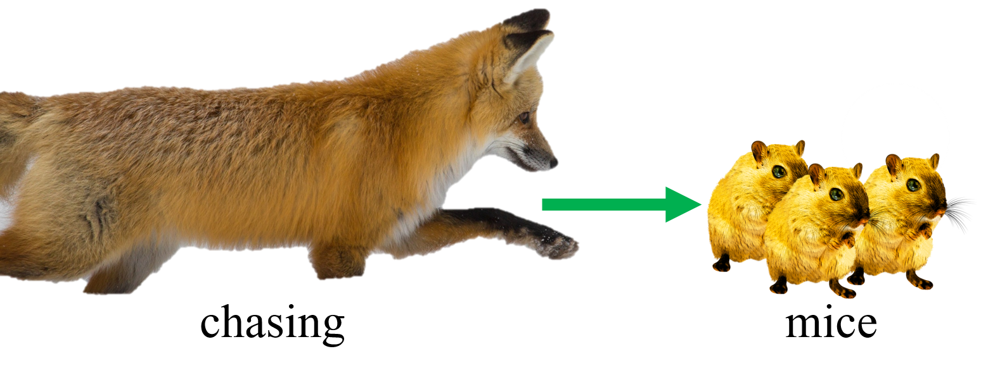
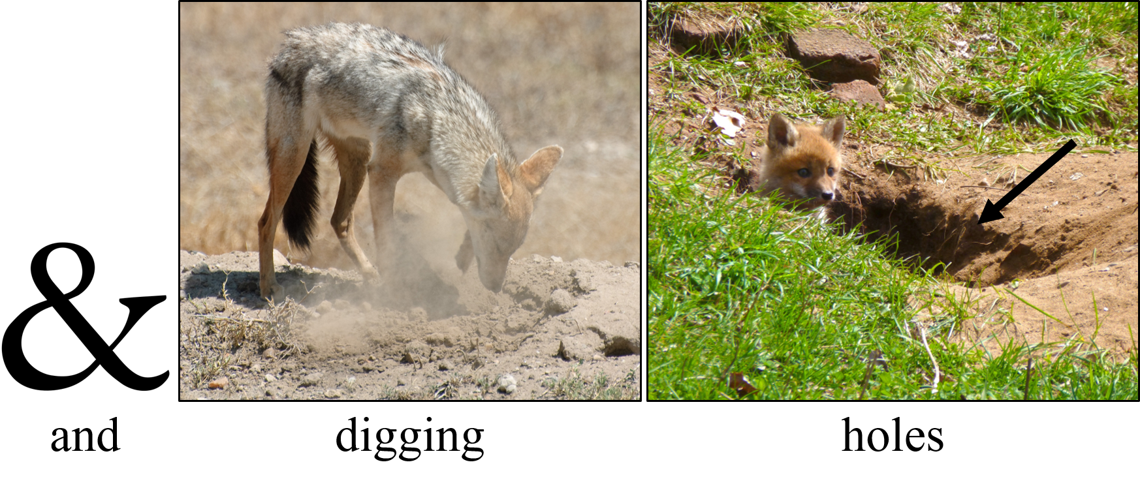
9
picturelyrics.org

Slide 11
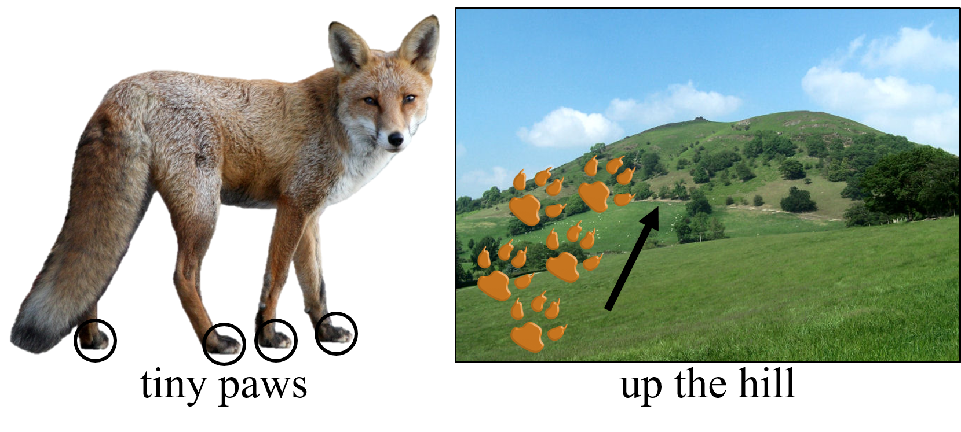
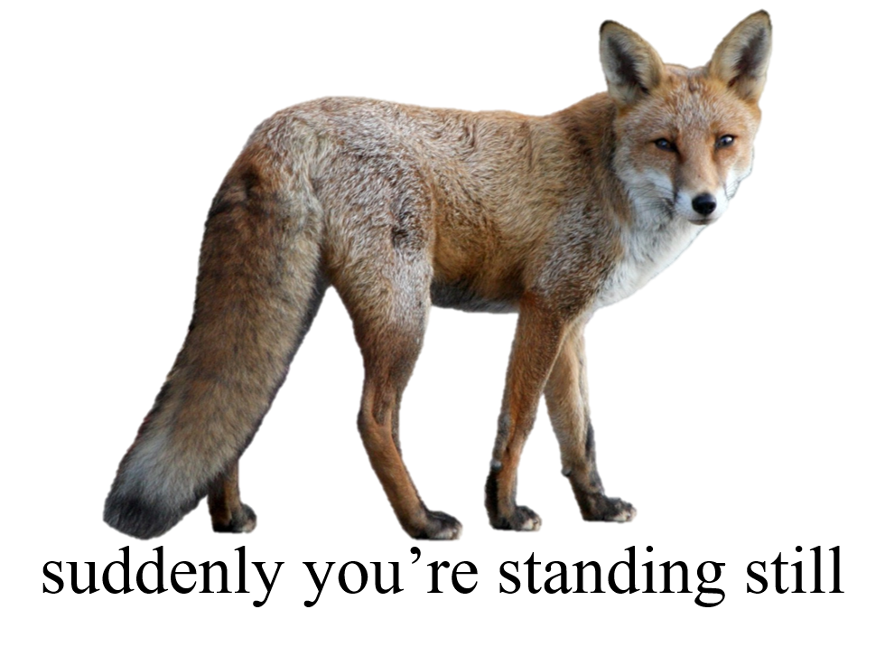
10
picturelyrics.org

Slide 12




11
like an angel
in disguise
picturelyrics.org

Slide 13
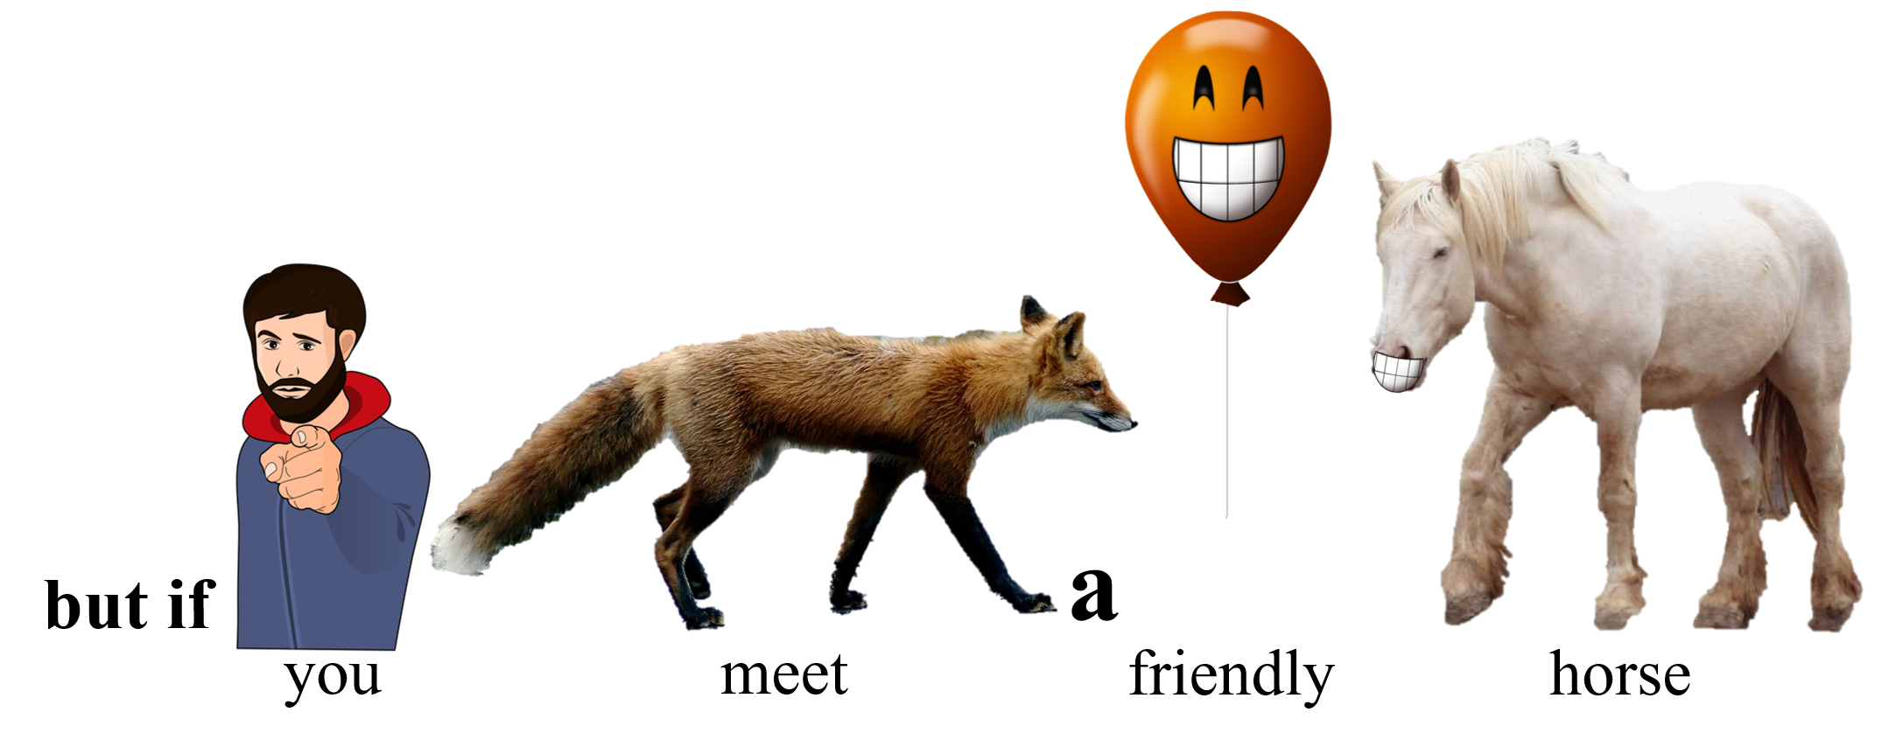
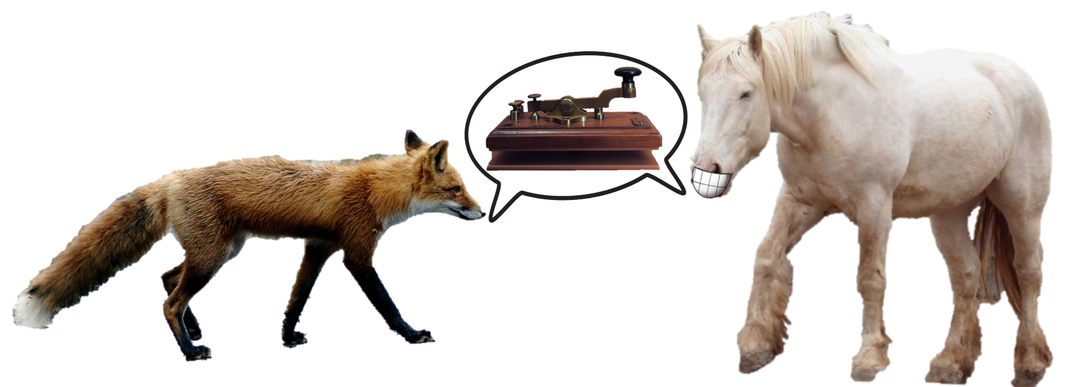

12
will
you
communicate by mo-o-o-o-orse
picturelyrics.org

Slide 14
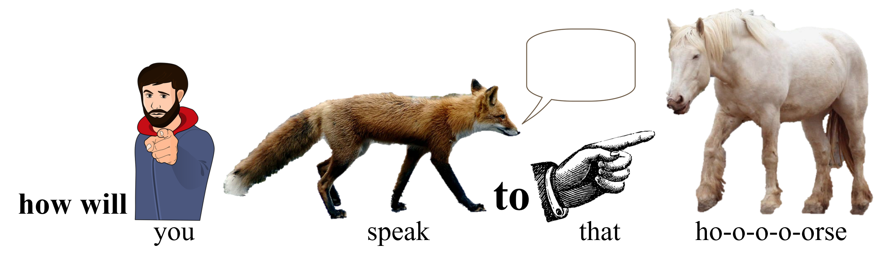
13
picturelyrics.org

Slide 15

14
jacha-chacha-chacha-chow
chacha-chacha-chacha-chow
jacha-chacha-chacha-chow
picturelyrics.org

Slide 16

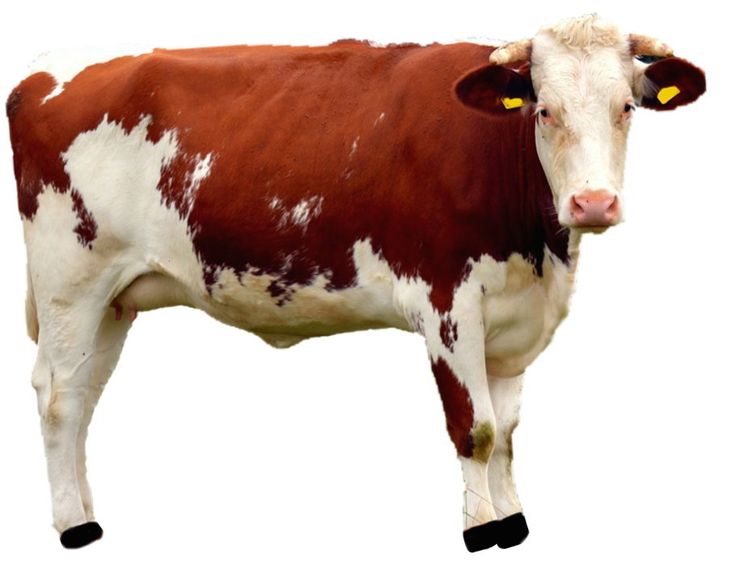


15
fraka-kaka-kaka-kaka-cow
fraka-kaka-kaka-kaka-cow
fraka-kaka-kaka-kaka-cow
a-hee-ahee ha-hee
a-hee-ahee ha-hee
a-hee-ahee ha-hee
picturelyrics.org

Slide 17
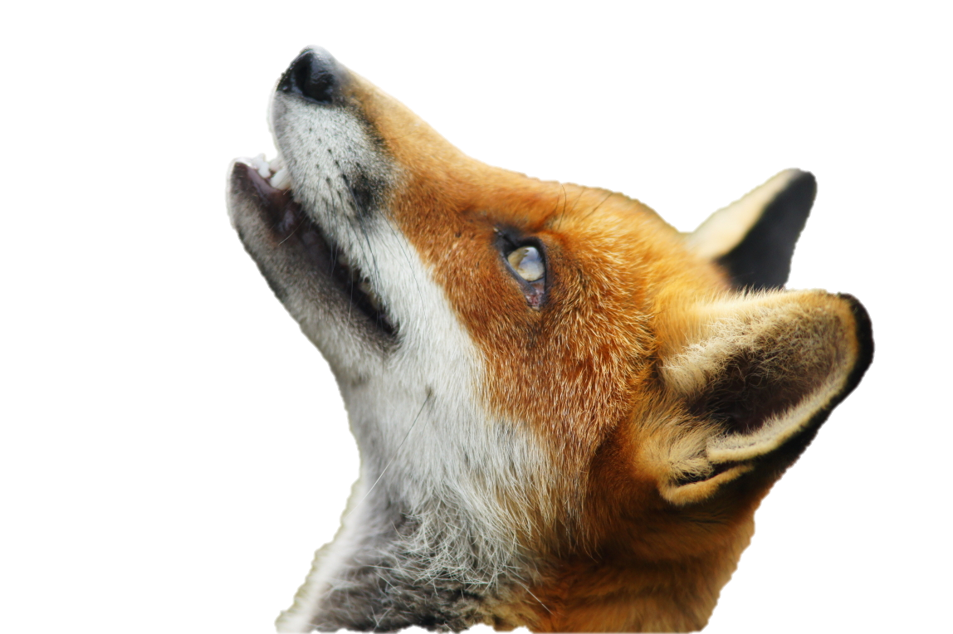
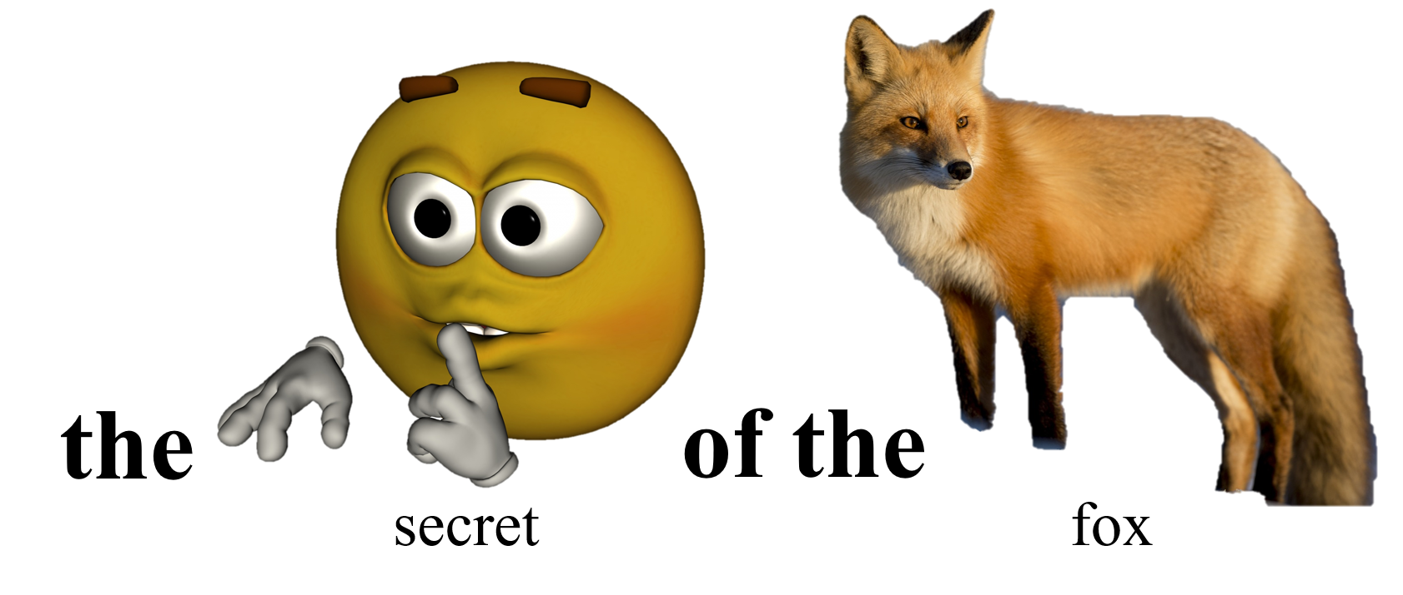
16
a-oo-oo-oo-ooo
woo-oo-oo-ooo
picturelyrics.org

Slide 18
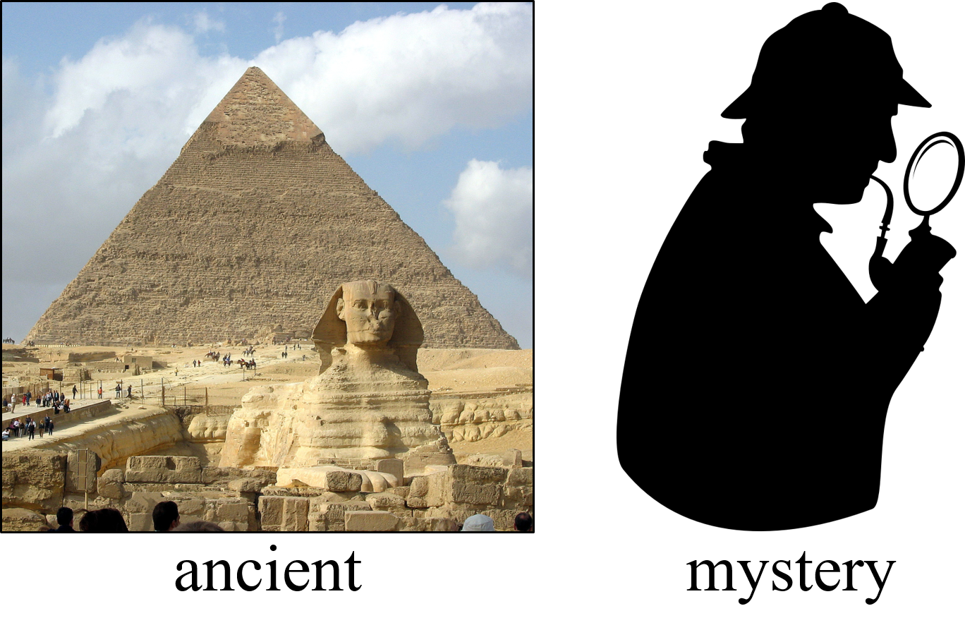
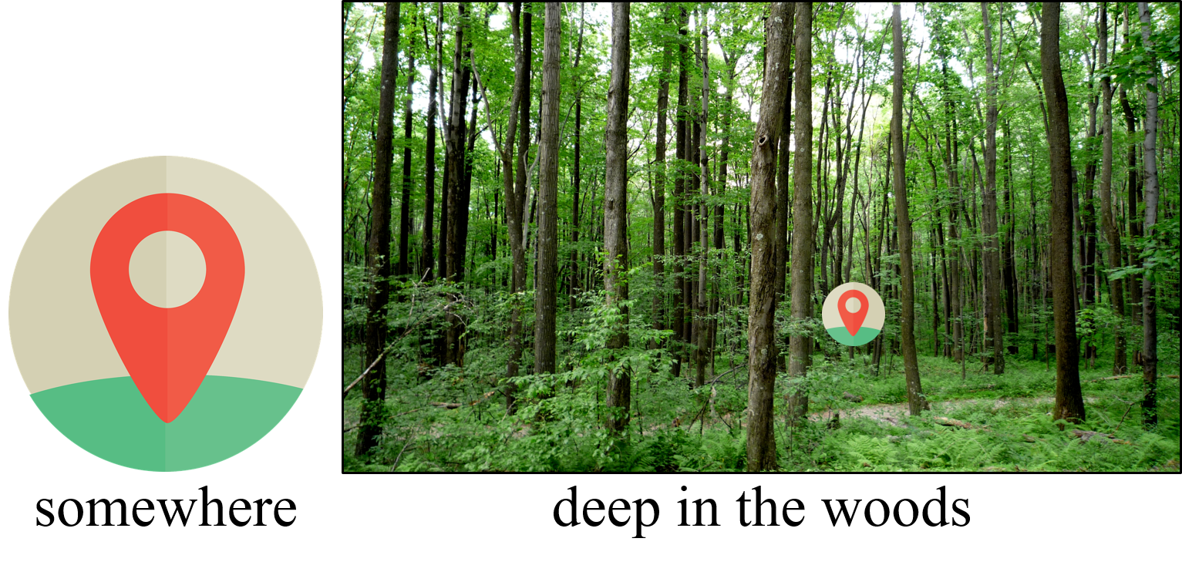
17
picturelyrics.org

Slide 19
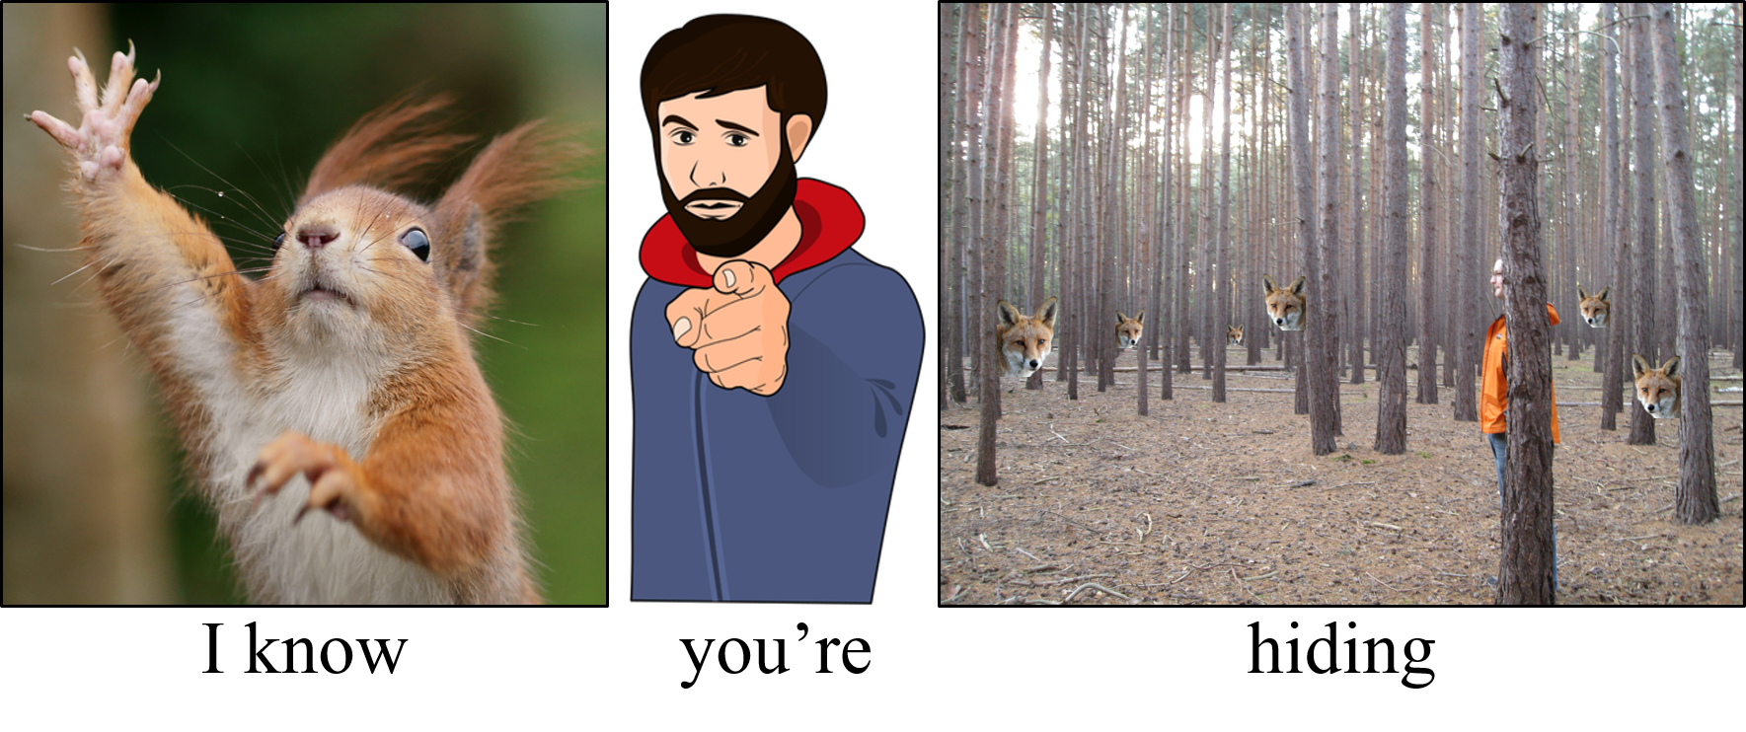
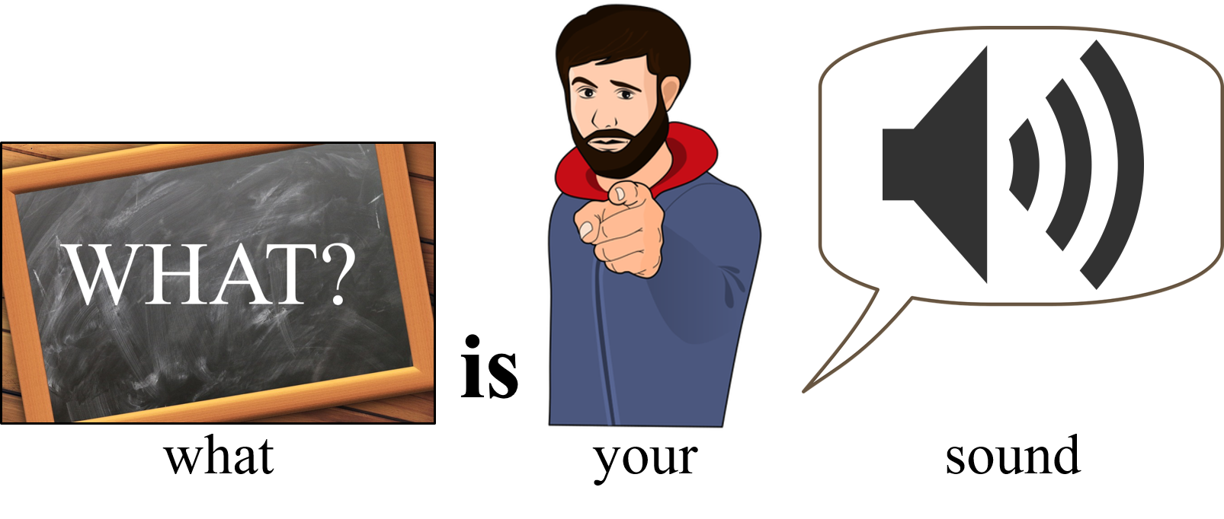
18
picturelyrics.org

Slide 20
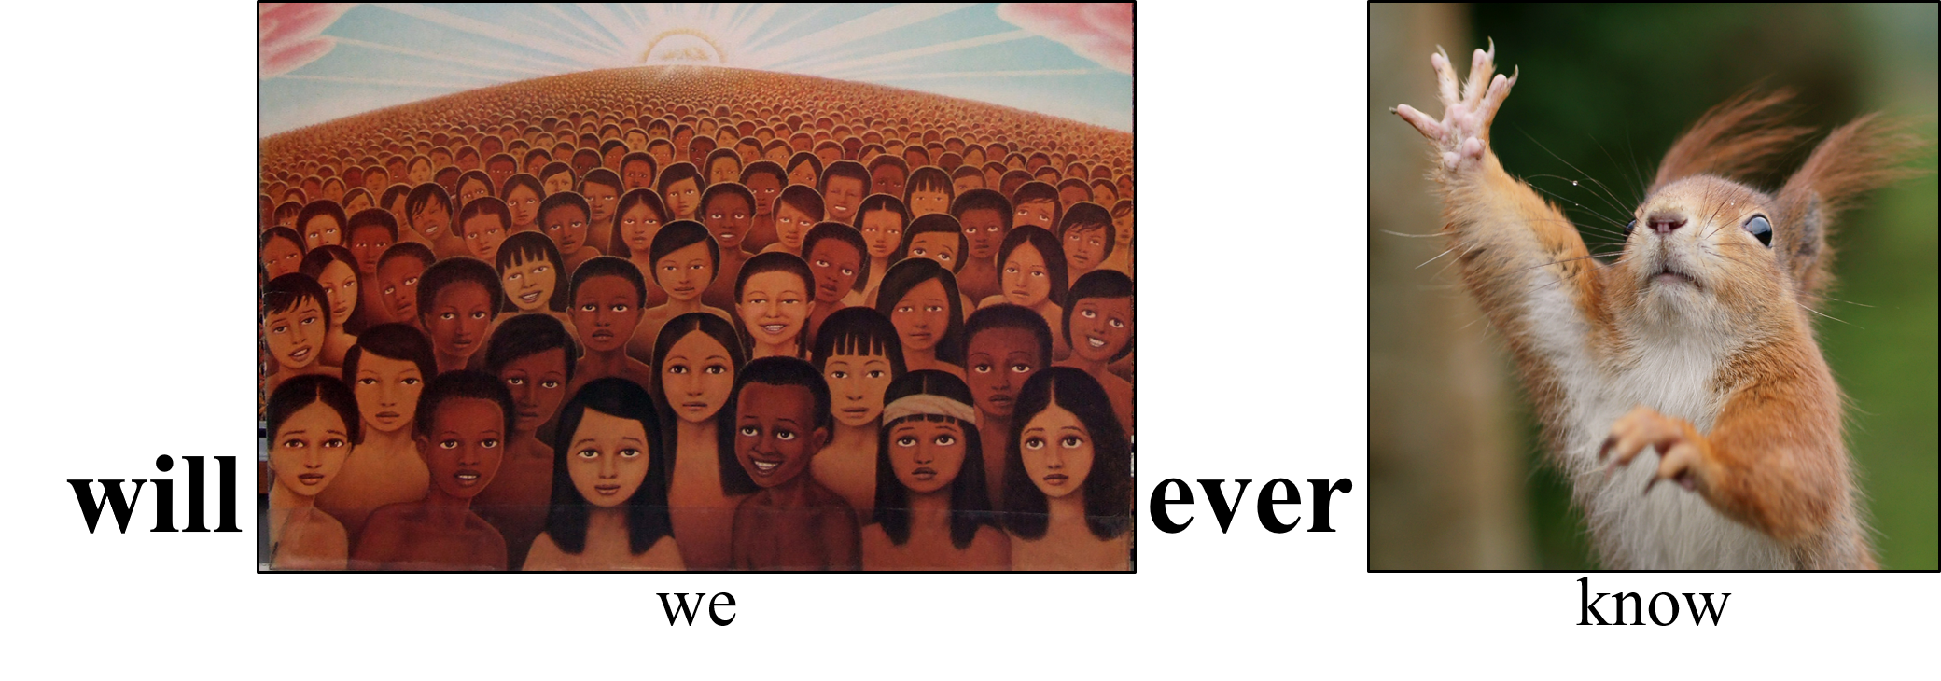

19
picturelyrics.org

Slide 21
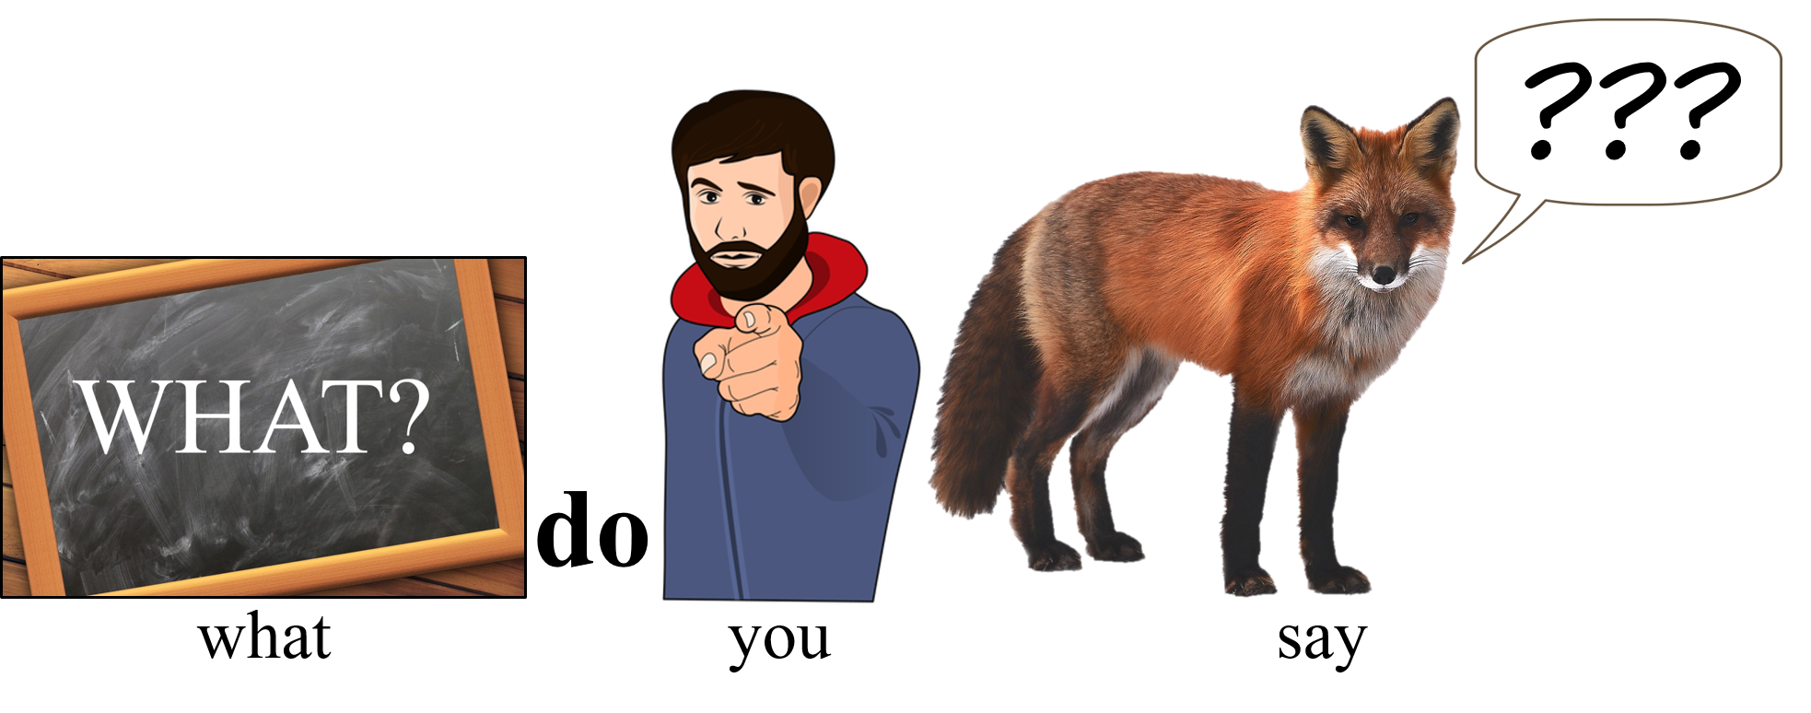
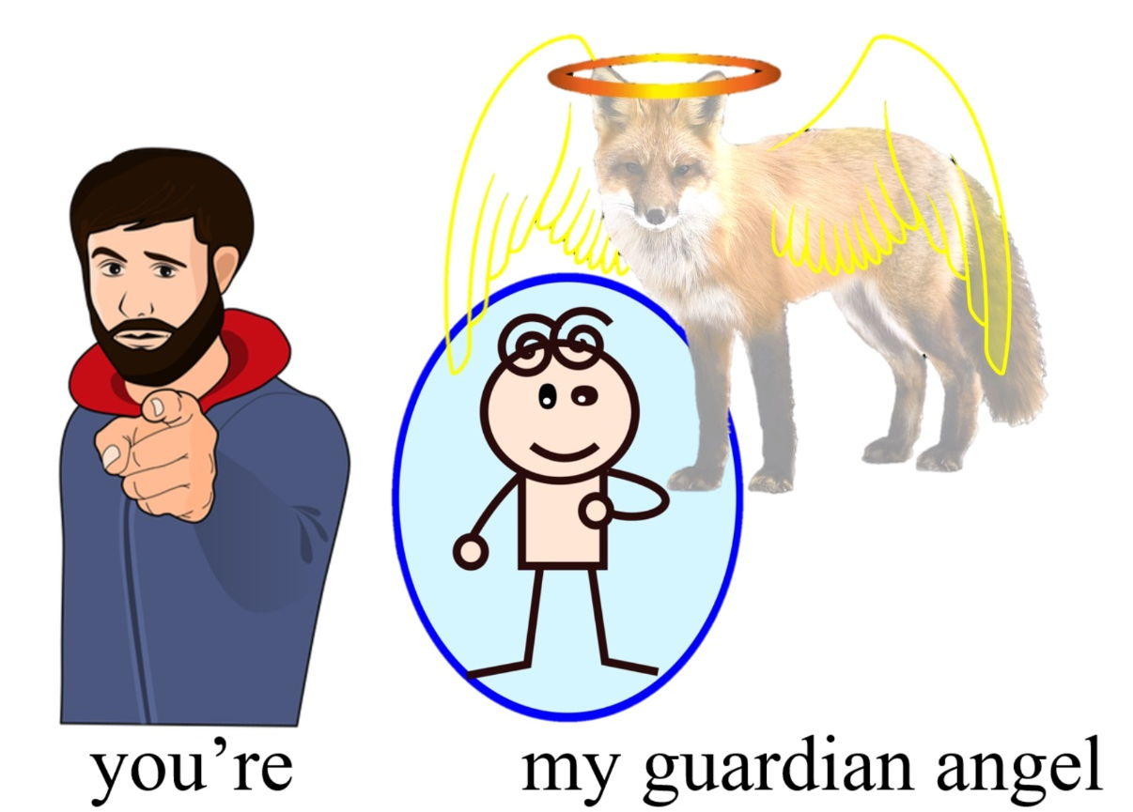
20
picturelyrics.org

Slide 22
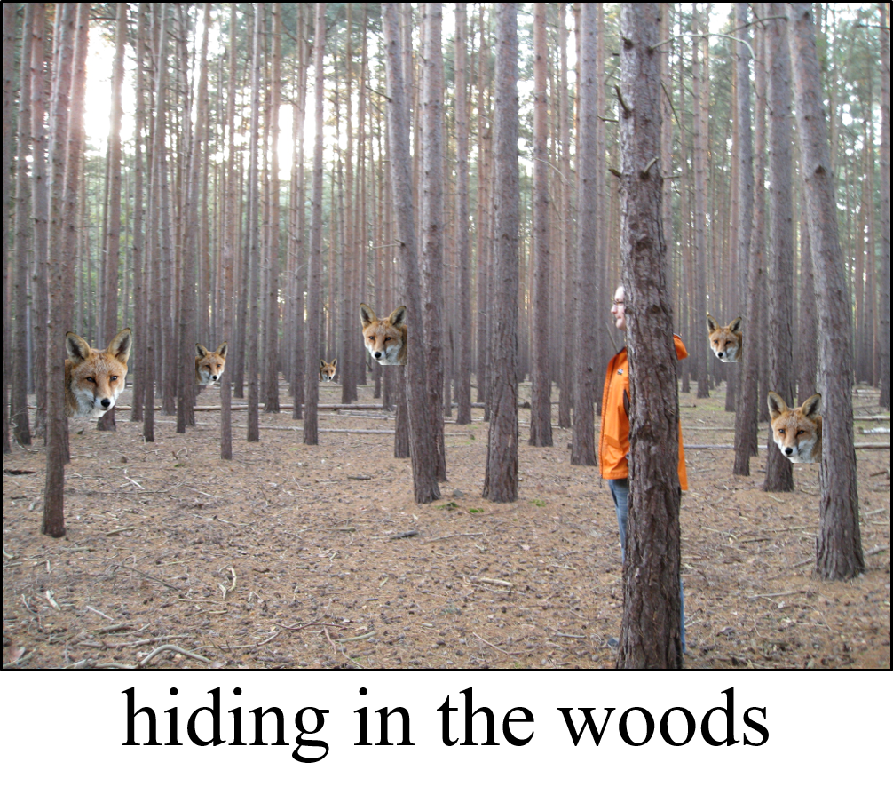
21
picturelyrics.org

Slide 23
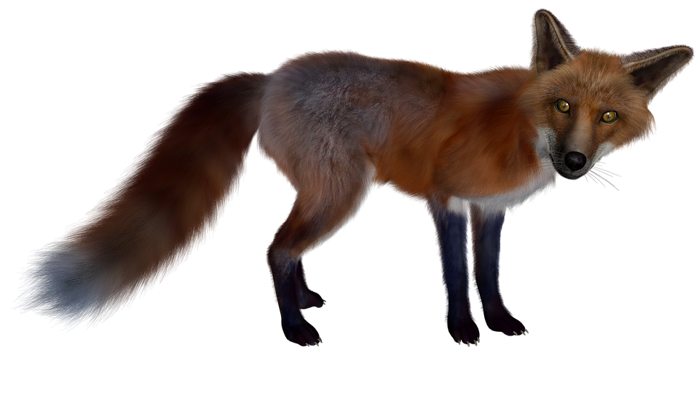
22
picturelyrics.org
a-dum-bum-bum-way-dum
buh-bi-dip-bip-bum-way-dum
a-dum-bum-bum-way-dum

Slide 24
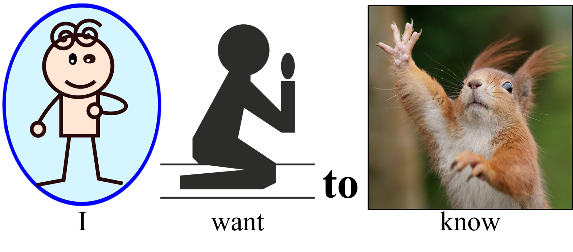
23
bi-be-dee-bop-bop-bay-dum
ba-buh-dum-bay-dum
abay-bi-dee-bum-bum-bay-dum
picturelyrics.org

