Slide 1

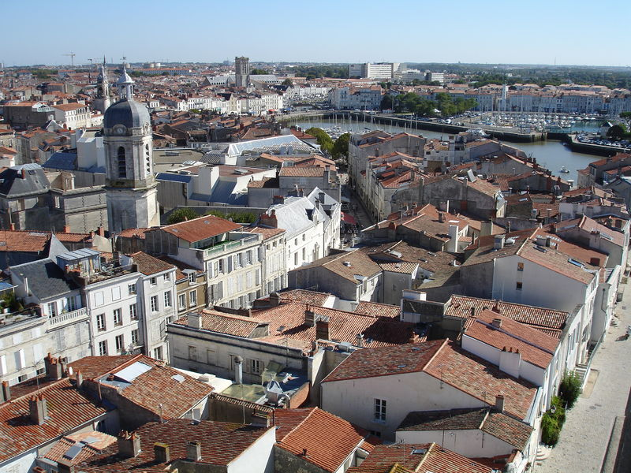
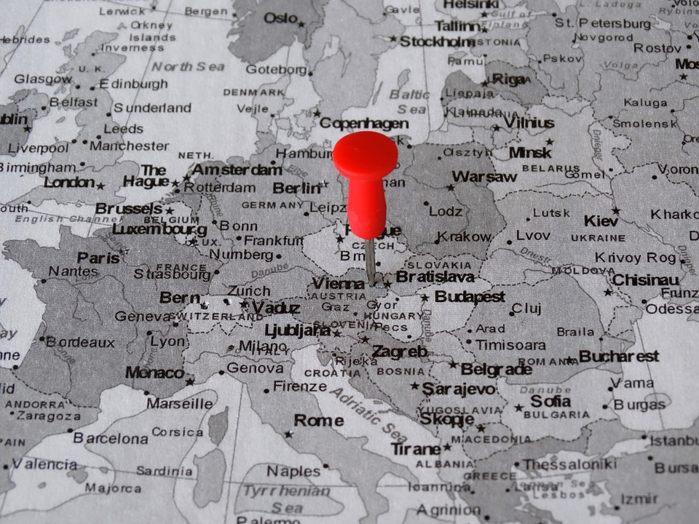

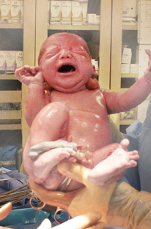
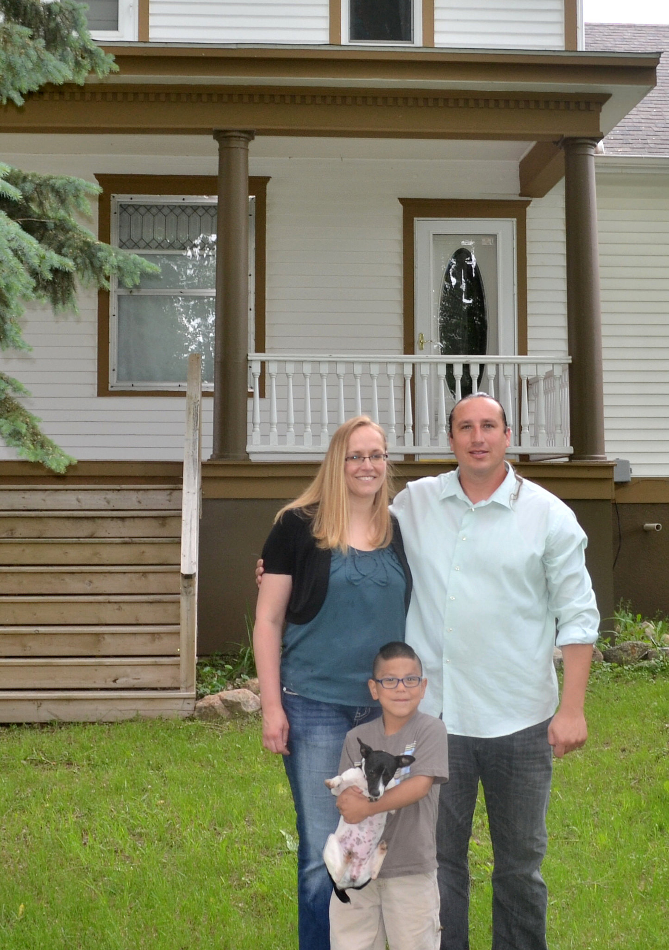
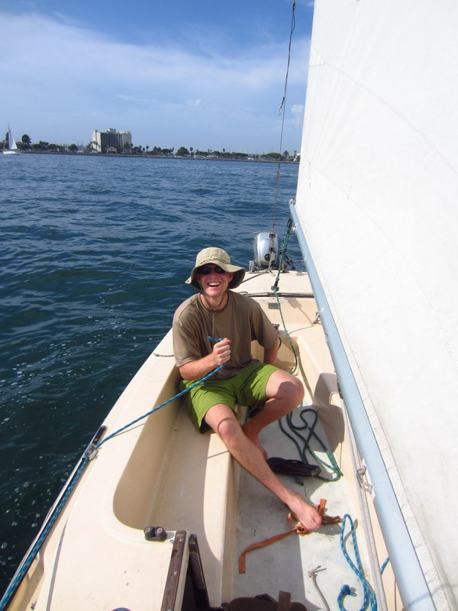

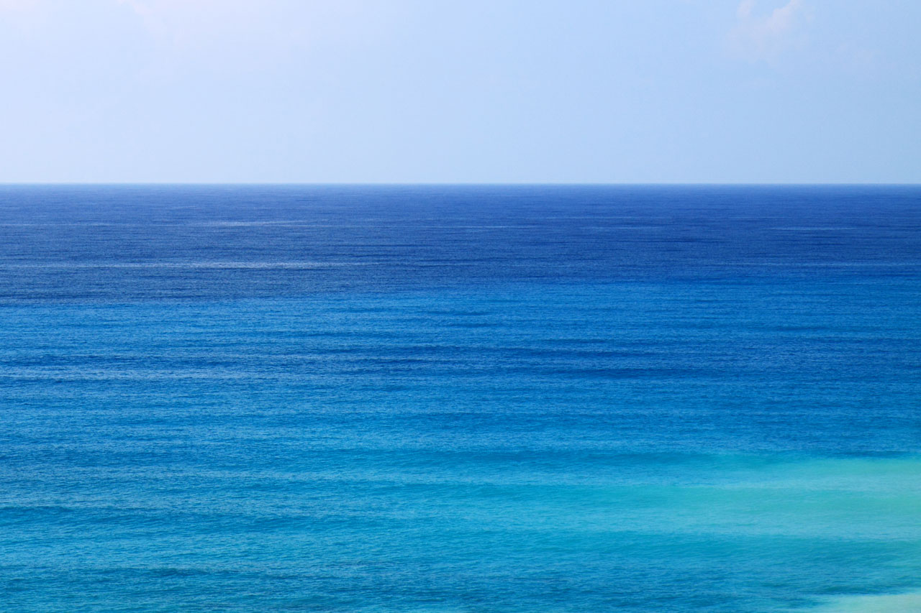
1
the
in
town
was
where
I
born
a
lived
man
who
picturelyrics.org
sailed
to
sea

Slide 2

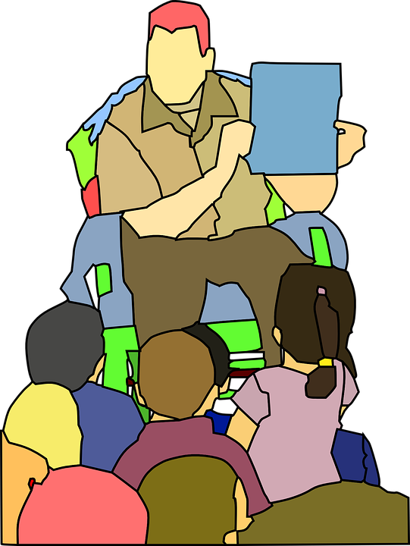
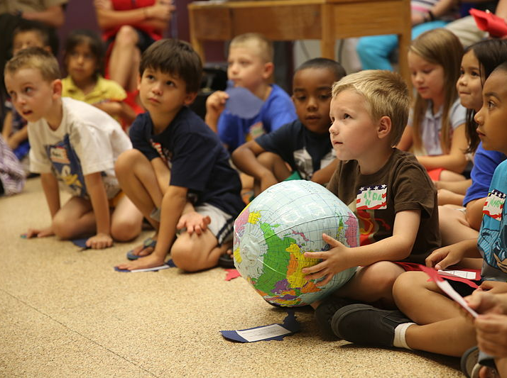
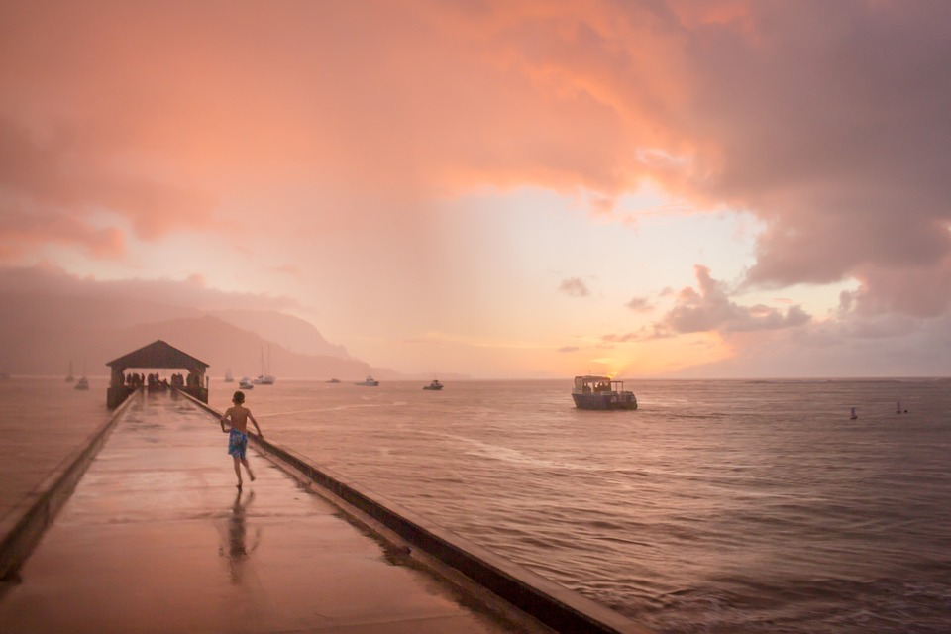



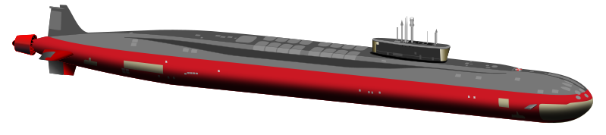
2
and
he
told
of
us
his life
the
in
land
of
picturelyrics.org
submarines

Slide 3
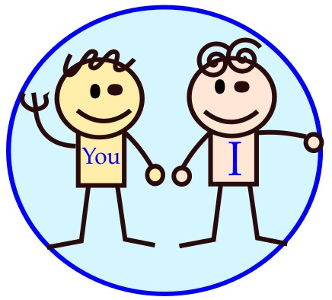
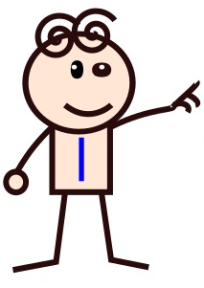

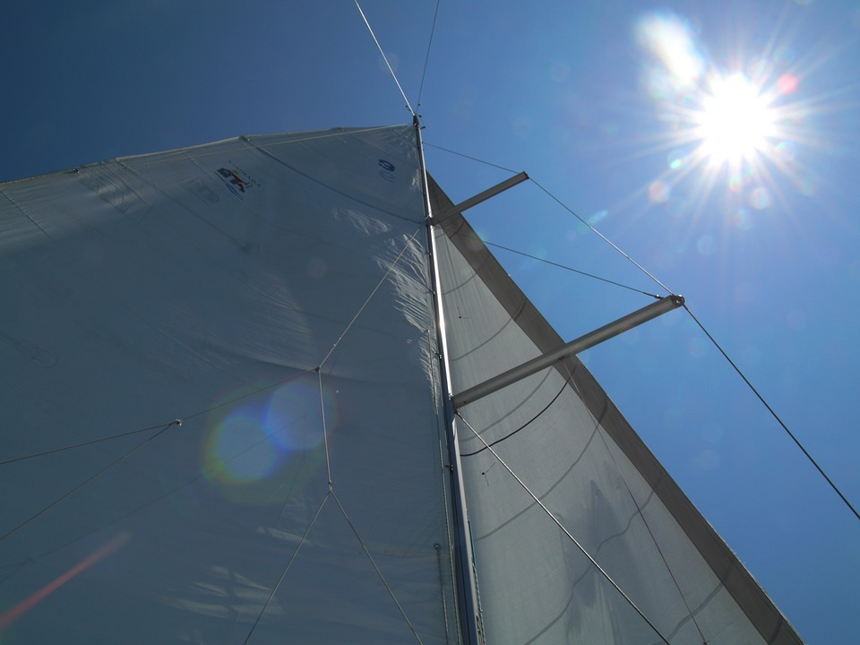

3
so
we
sailed
the
to
up
sun
‘til
we
found
the
of
picturelyrics.org
sea
green

Slide 4
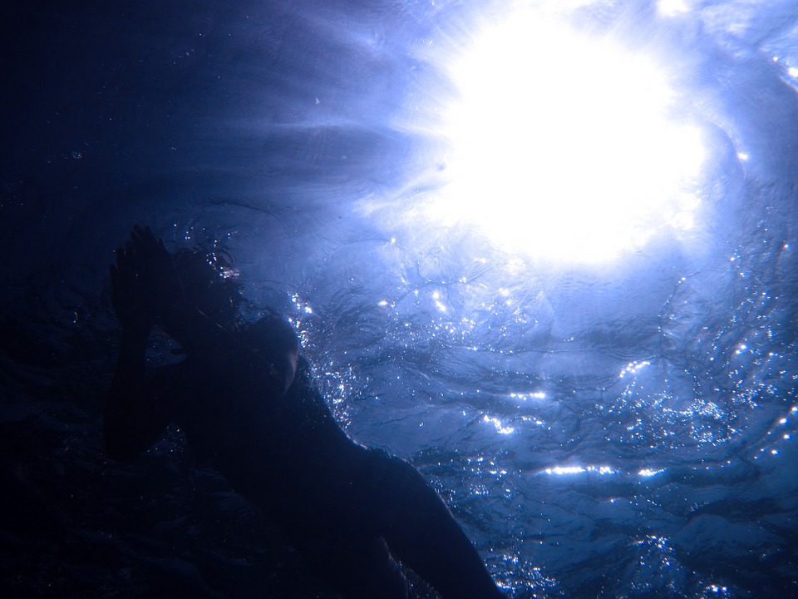
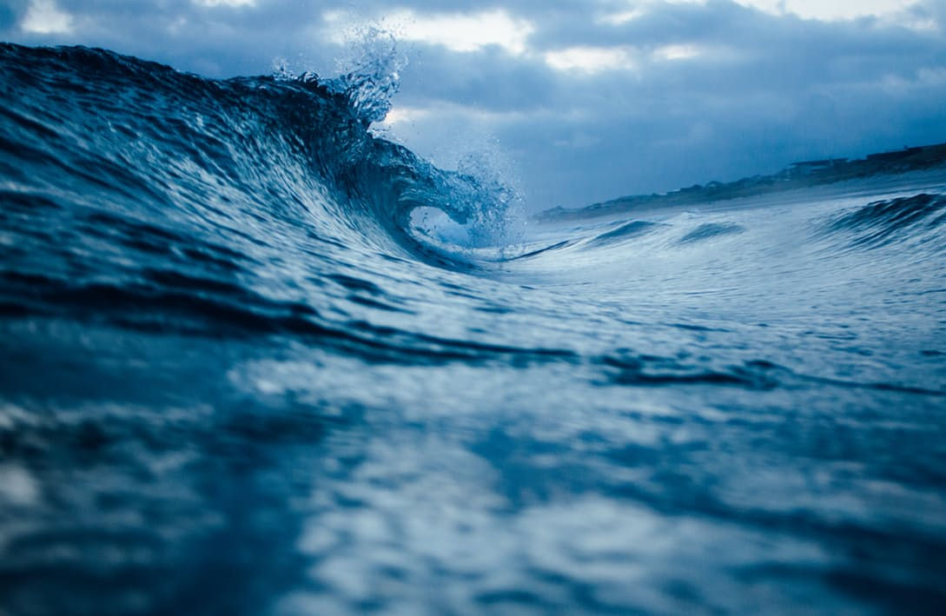


4
and
we
lived
the
beneath
waves
in
our yellow submarine
picturelyrics.org

Slide 5

5
we
all
live
a
in
yellow submarine
yellow submarine
(2x)
yellow submarine
picturelyrics.org

Slide 6
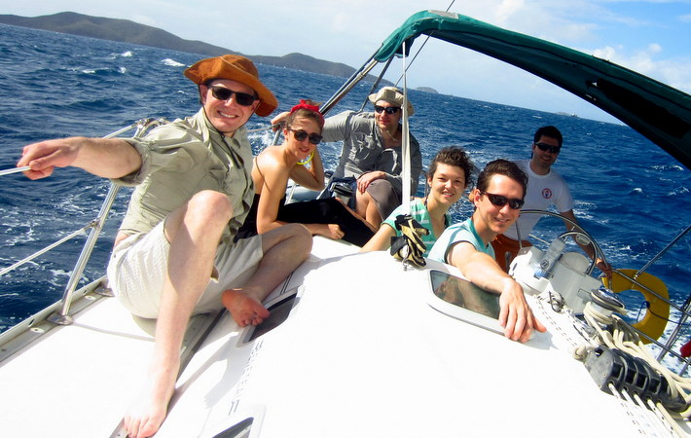
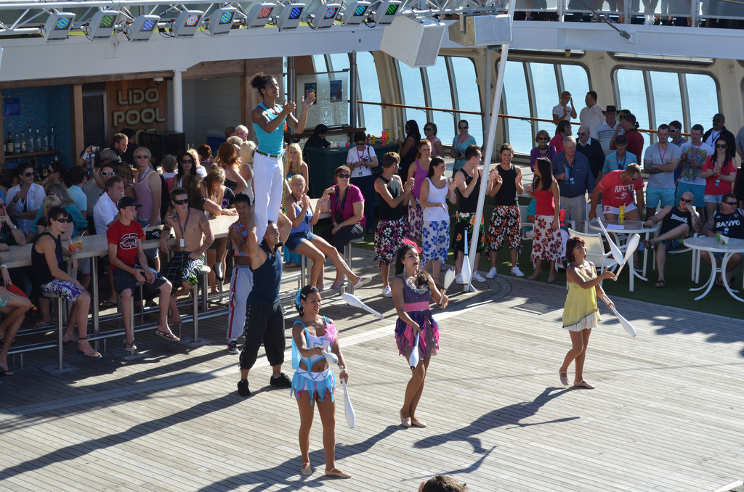
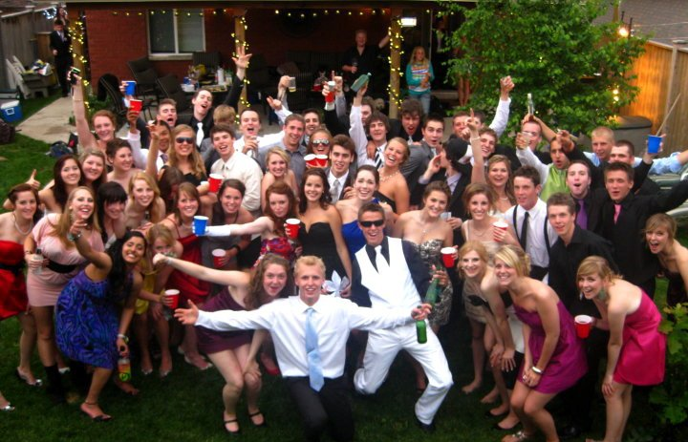
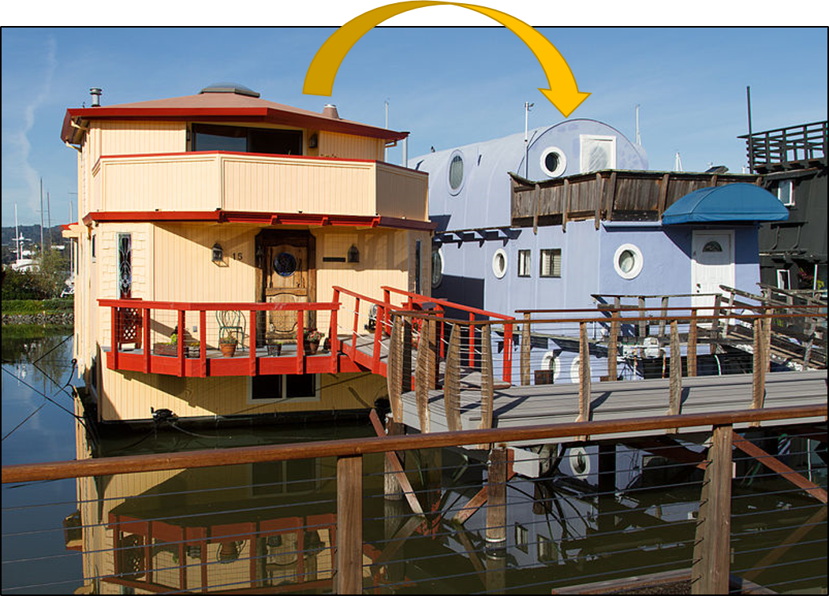
6
and
our
friends
are
all
aboard
of
many more
them
live
next door
picturelyrics.org

Slide 7
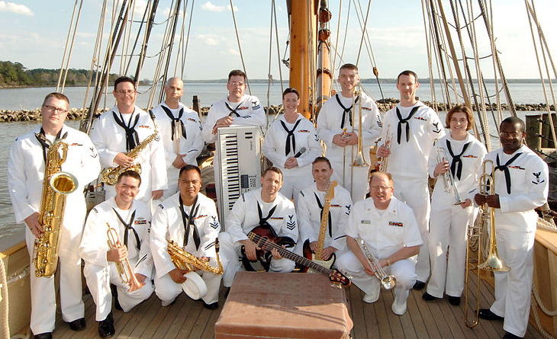
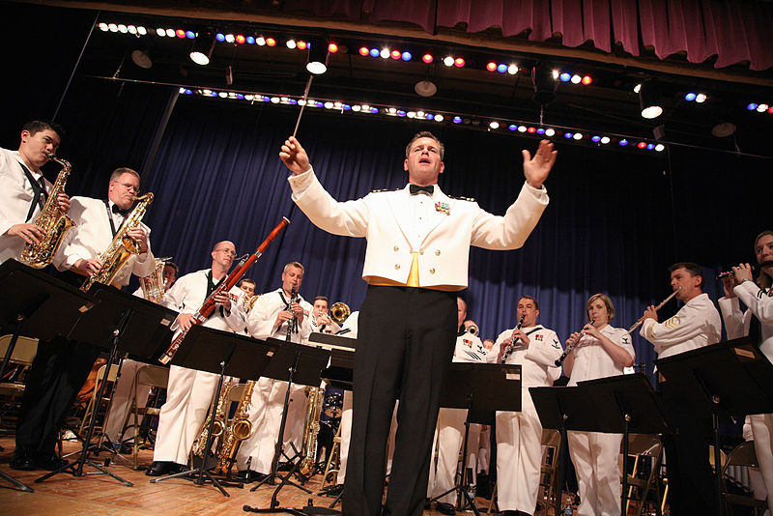


7
and the
band
to
begins
play
p. 5
(musical interlude)
picturelyrics.org

Slide 8

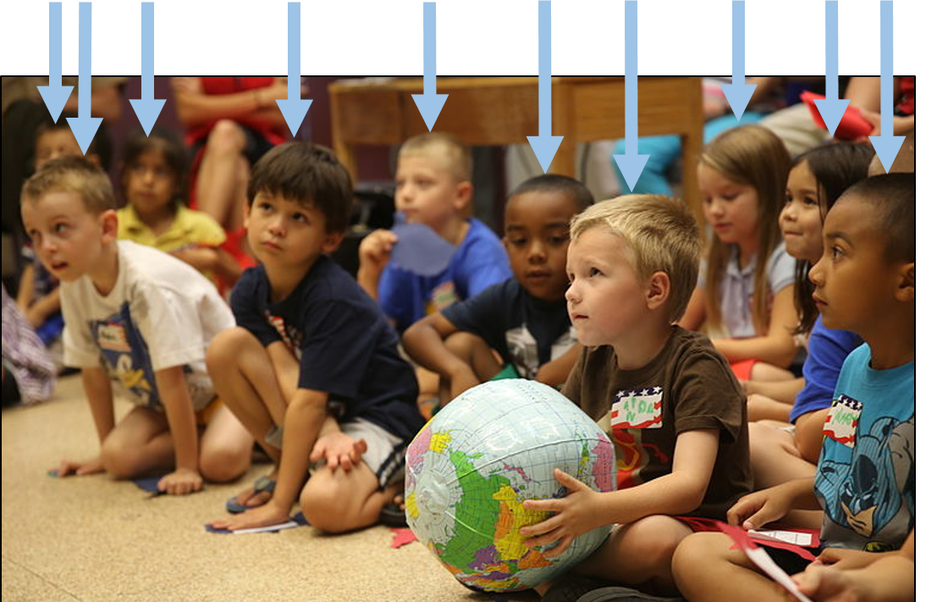
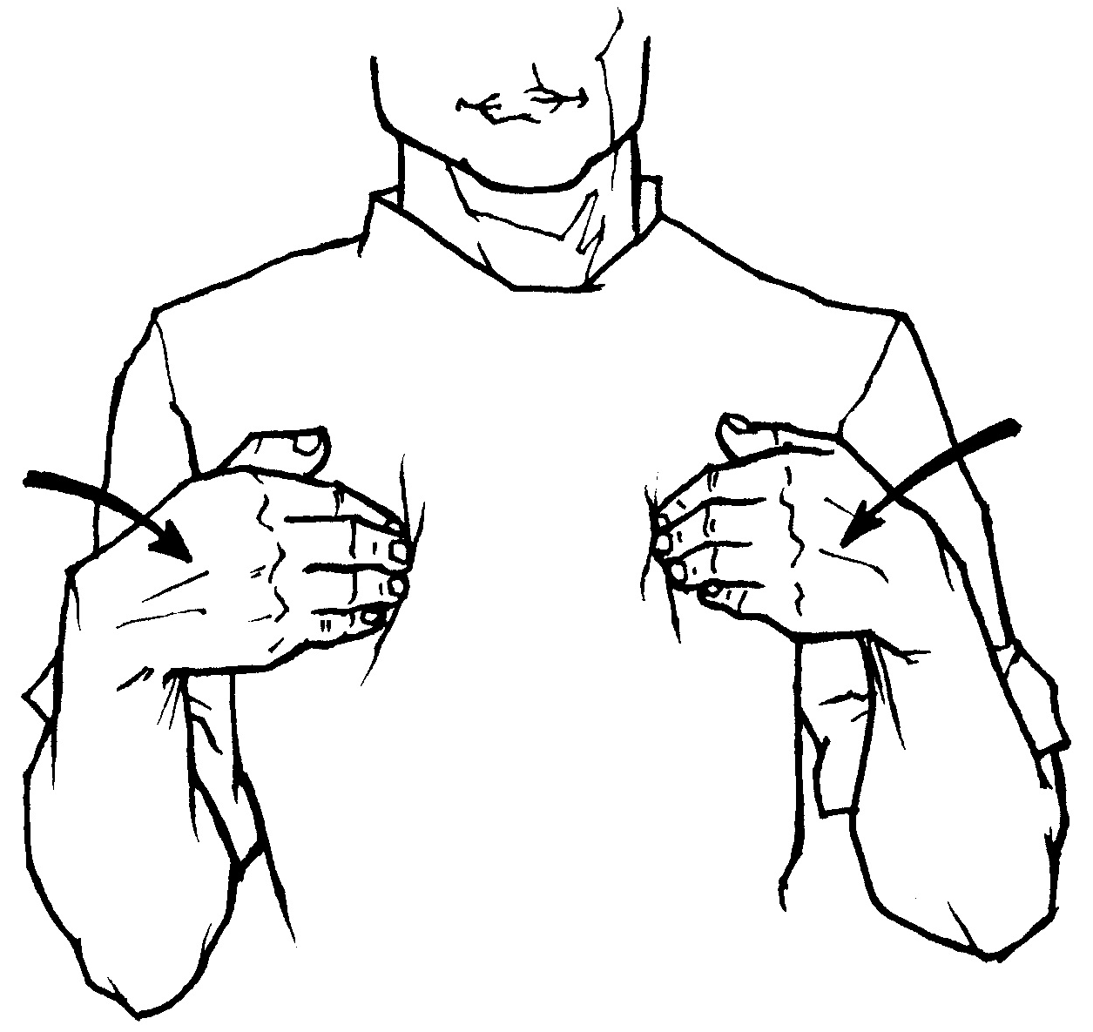

8
as
we
live
a
of
life
ease
of
every one
us
has
all we need
picturelyrics.org

Slide 9

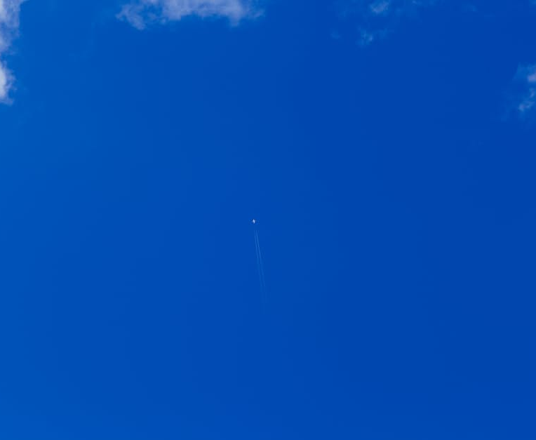
9
of
sky
blue
and
of
sea
green
in
picturelyrics.org
our yellow submarine

