Slide 1
1
picturelyrics.org

Slide 2
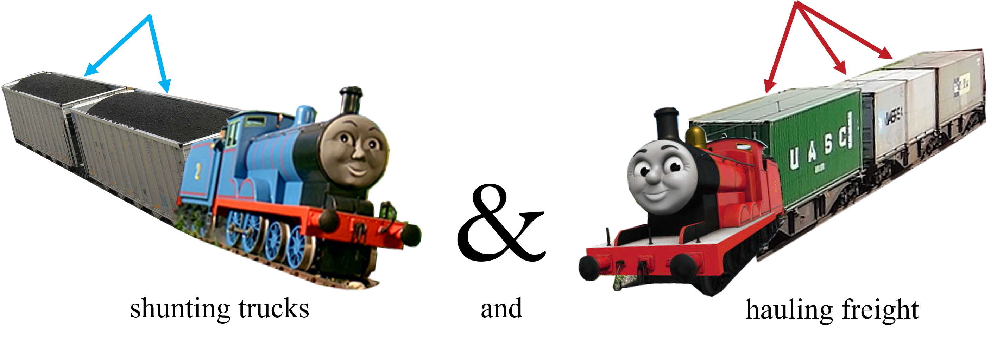
2
picturelyrics.org

Slide 3
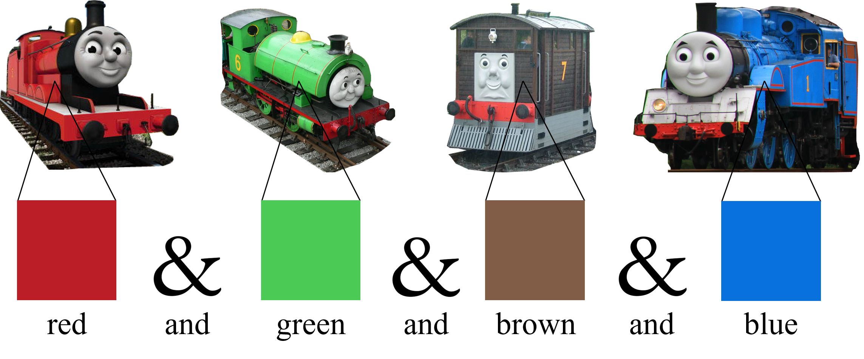
3
picturelyrics.org

Slide 4
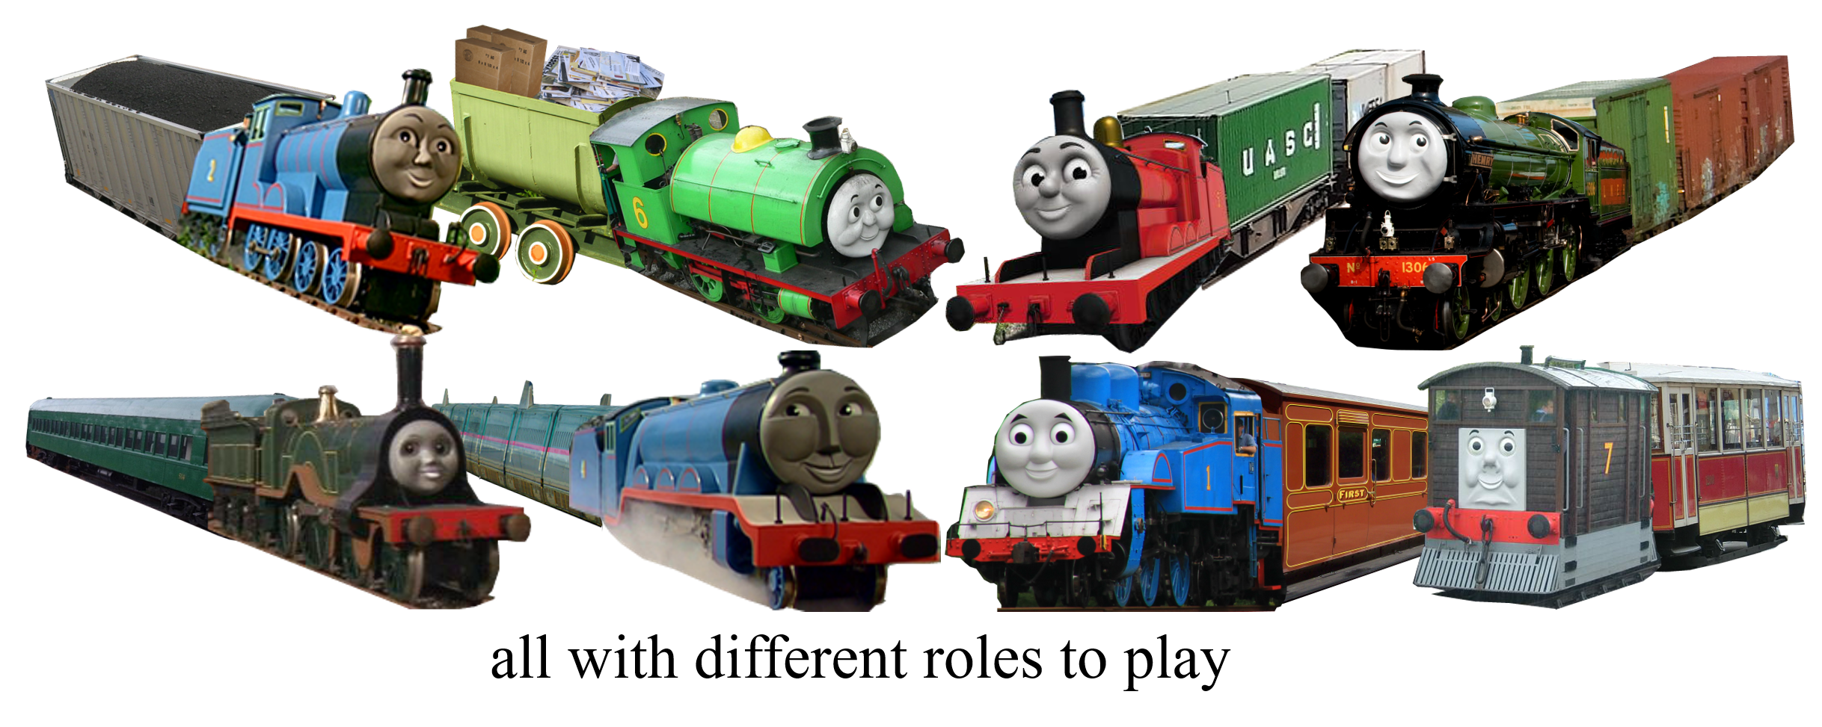
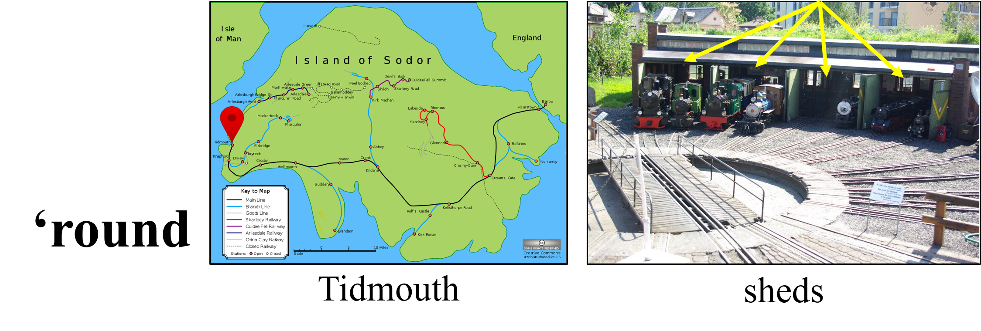
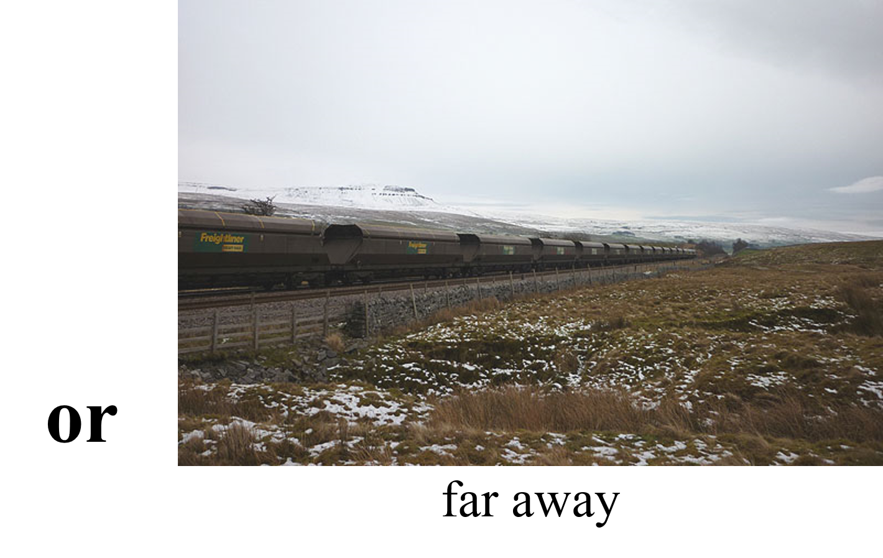
4
picturelyrics.org

Slide 5
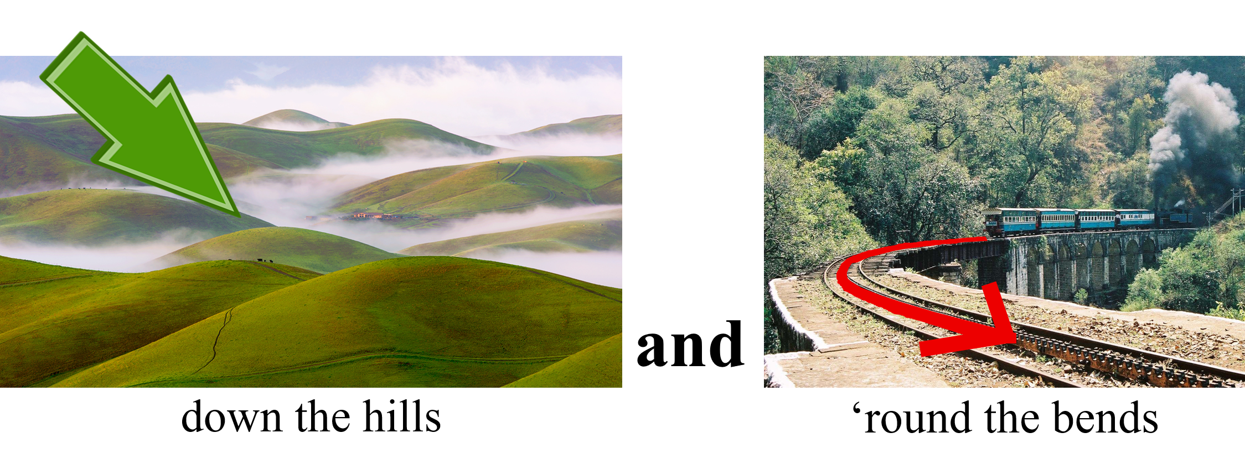
5
picturelyrics.org

Slide 6
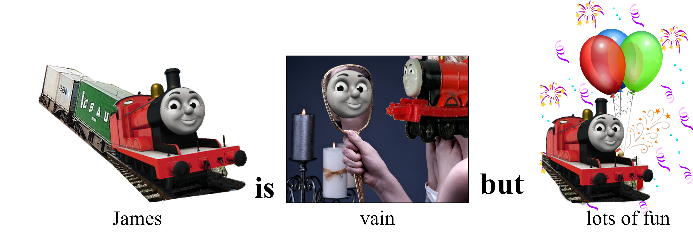
6
picturelyrics.org

Slide 7
7
picturelyrics.org

Slide 8
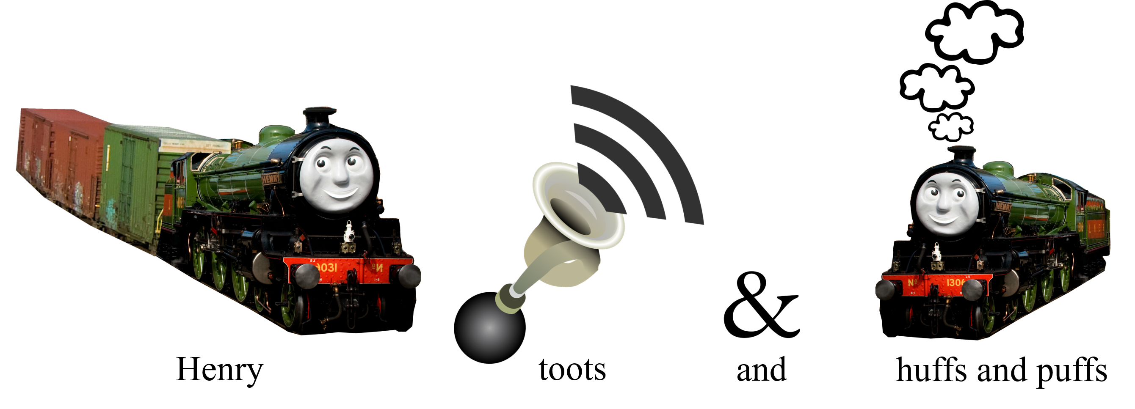
8
picturelyrics.org

Slide 9
9
picturelyrics.org

