Slide 1





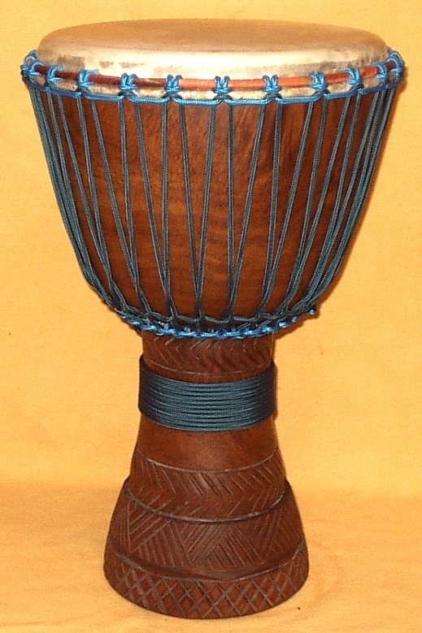
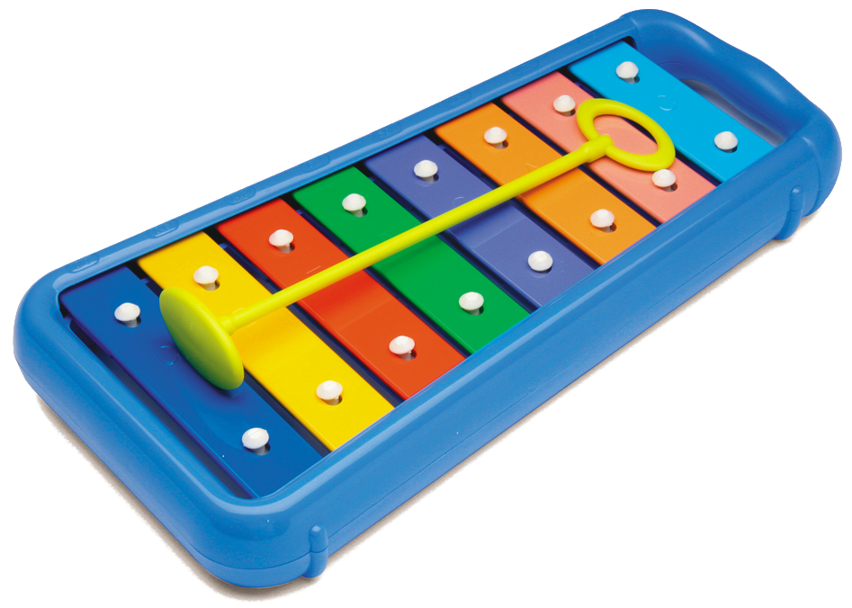



English Music Check Sheet
Name: ___________________________
Sing
Actions
PictureLyrics
K1
K2
Drum
Glockenspiel
Vocabulary
K3
All Clear

Slide 2

English Music Check Sheet
Name: ___________________________
All Clear

