Slide 1



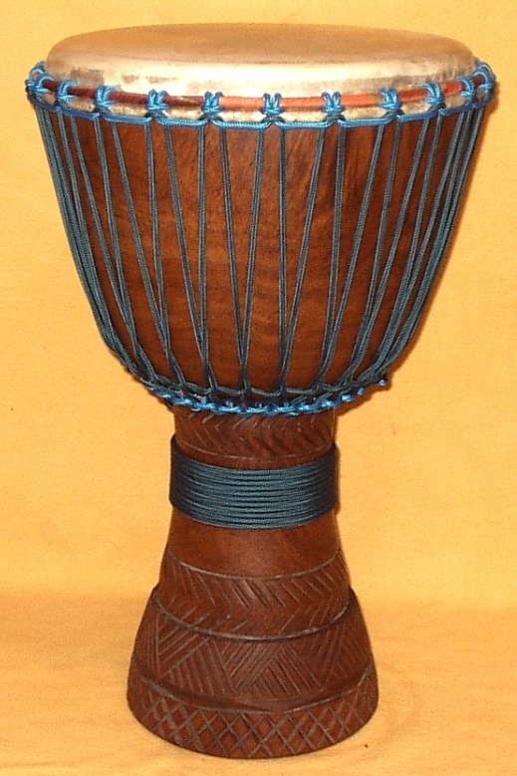
Hello How Are You
 | 1 | 2 | 3 | 4 | 1 | 2 | 3 | 4 | 1 | 2 | 3 | 4 | 1 | 2 | 3 | 4
1) |  |  |  | G | G | E |  | G | G | E |  | G | A | G | F | E
1)
1)
2) | D |  |  | F | D |  |  | F | D |  |  | F | G | F | E | D
2)
2)
3) | C
3)
3)

Slide 2
Hello How Are You
 | 1 | 2 | 3 | 4 | 1 | 2 | 3 | 4 | 1 | 2 | 3 | 4 | 1 | 2 | 3 | 4
1) |  |  |  | G | G | E |  | G | G | E |  | G | A | G | F | E
1)
1)
2) | D |  |  | F | D |  |  | F | D |  |  | F | G | F | E | D
2)
2)
3) | C
3)
3)

