Slide 1

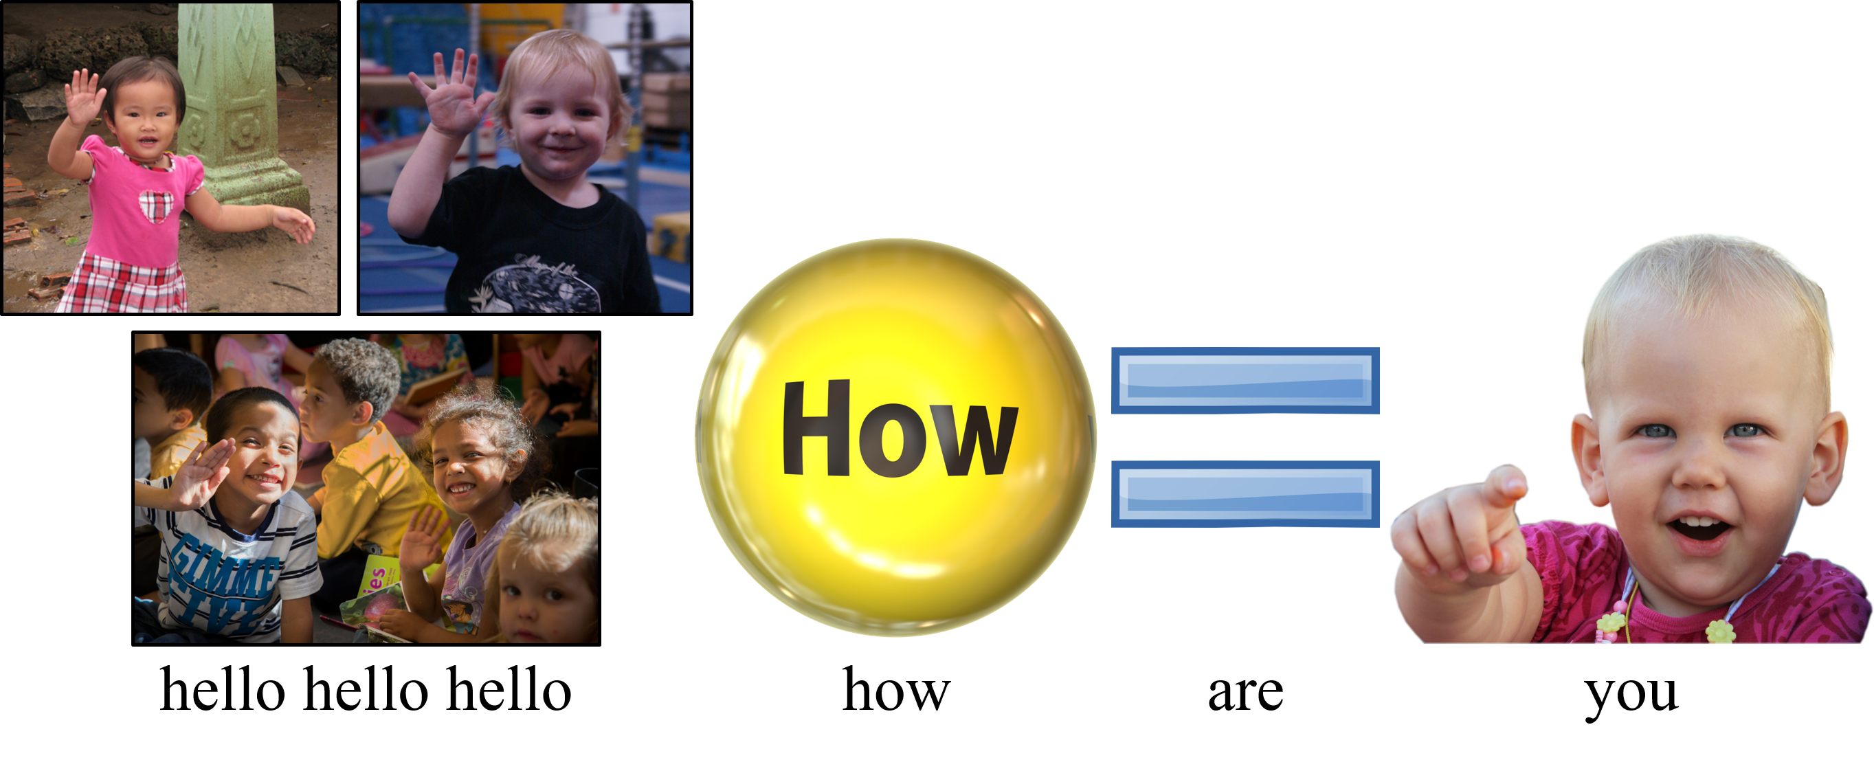
1
picturelyrics.org

Slide 2


2
picturelyrics.org

